Slide 1





Scalable Analytics on
Large Sequence Collections
Karima Echihabi Themis Palpanas
Mohammed VI Université Paris Cité &
Polytechnic University French University Institute (IUF)
International Conference on Mobile Data Management (MDM), June 2022

Slide 2
Questions This Tutorial Answers
how important are data series nowadays?
what does data series analysis involve?
how can we speed up such an analysis?
what are the different kinds of similarity search?
what are the state-of-the-art data series indices for similarity search?
can such indices help with geolocated data series analysis?
how can these indices parallelize/distribute their operations?
can these indexes be used for general high-d vector similarity search?
what are the open research problems in this area?
what are the connections to deep learning?

Slide 3
Acknowledgements
thanks for slides to
  Michail Vlachos
  Panagiotis Papapetrou
  George Kollios
  Dimitrios Gunopulos
  Christos Faloutsos
  Panos Karras
  Peng Wang
  Liang Zhang
  Reza Akbarinia
  Georgios Chatzigeorgakidis

Slide 4
Introduction, Motivation

Slide 5
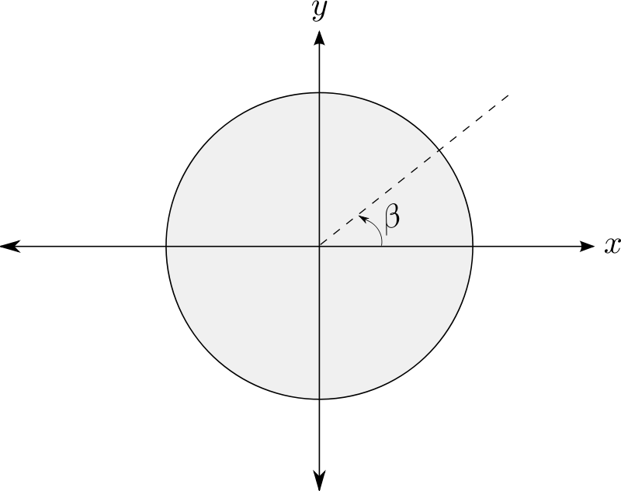



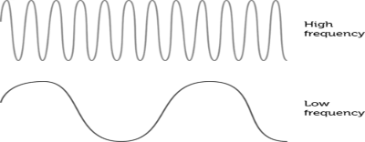
Data series
Sequence of points ordered along some dimension
value
x₁
x₂
…
x_{n}
v₂
v₁
sequence dimension
Angle
Time
Position
Mass
Frequency

Slide 6
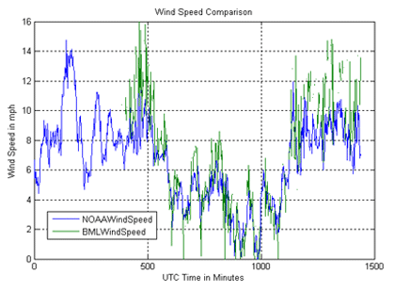

Scientific Monitoring
meteorology, oceanography, astronomy,
finance, sociology, …
Wind speed
From ocean observing node project
http://bml.ucdavis.edu/boon/wind.html
Historical stock quotes
http://money.cnn.com/2012/04/23/markets/walmart_stock/index.htm
Time

Slide 7
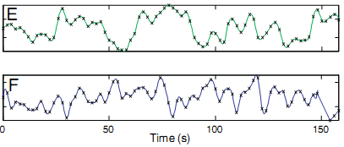
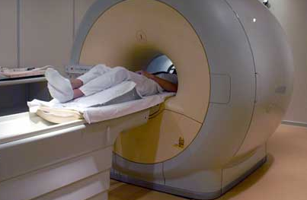
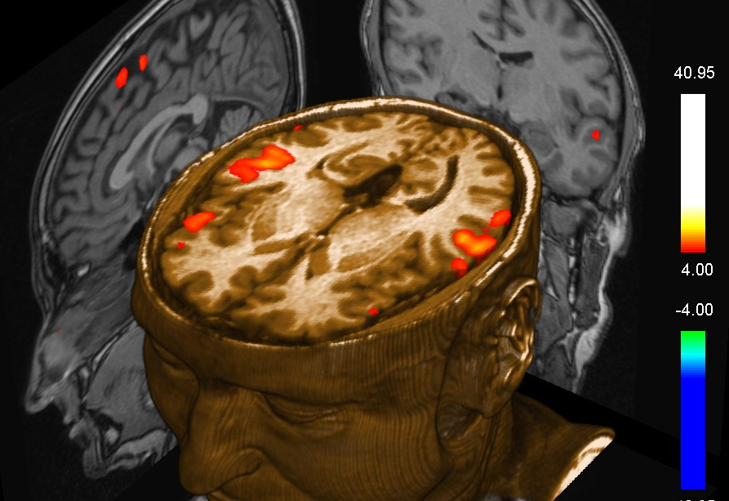
Neuroscience
functional Magnetic Resonance Imaging (fMRI) data
  primary experimental tool of neuroscientists
  reveal how different parts of brain respond to stimuli
Time

Slide 8
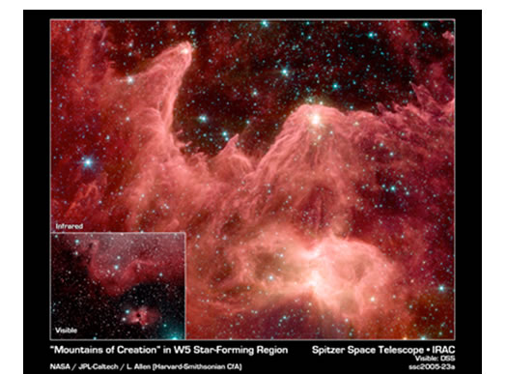
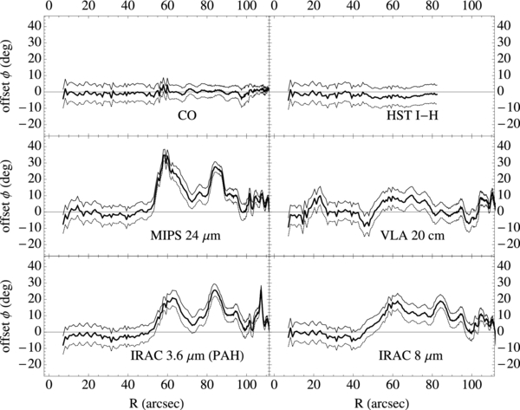
Angle
Schinnerer et al.
Notes:
radial profiles of chemical combounds emissions
THE PdBI ARCSECOND WHIRLPOOL SURVEY (PAWS). I. A CLOUD-SCALE/MULTI-WAVELENGTH VIEW OF THE INTERSTELLAR MEDIUM IN A GRAND-DESIGN SPIRAL GALAXY
Eva Schinnerer1, Sharon E. Meidt1, Jérôme Pety2,3, Annie Hughes1, Dario Colombo1, Santiago García-Burillo4, Karl F. Schuster2, Gaëlle Dumas2, Clare L. Dobbs5, Adam K. Leroy6, Carsten Kramer7, Todd A. Thompson8,9, and Michael W. Regan10

Slide 9
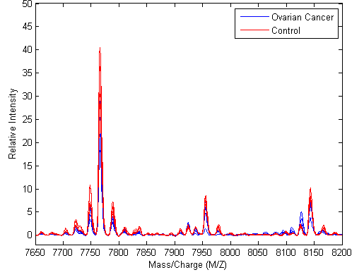
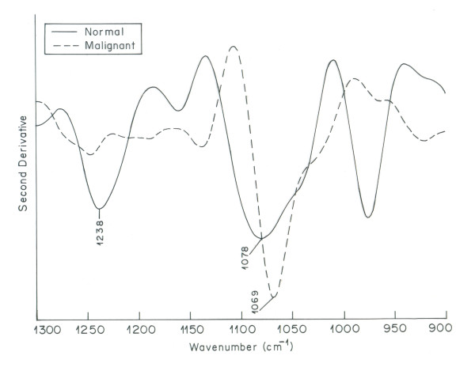
Medicine
Mass
Frequency
Notes:
spectra of ovarian tissues: some healthy (red), some malignant (cancer)
Mass spectroscopy
Mathworks & FDA-NCI Clinical Proteomics Program Databank
https://jp.mathworks.com/help/bioinfo/examples/batch-processing-of-spectra-using-sequential-and-parallel-computing.html
https://home.ccr.cancer.gov/ncifdaproteomics/
Infrared spectroscopy: IR light is emitted, and we measure response as a function of the wavelength/frequency (x-axis)
https://www.ncbi.nlm.nih.gov/pmc/articles/PMC3017039/

Slide 10
Analysis Tasks
analyze evolution of values across x-dimension
identify trends
treat data series as a first class citizen
  analyze each data series as a single object
  process all n-dimensions at once

Slide 11
Analysis Tasks
Subsequences
often times the data series are very long
  n >> 1
  streaming data series
we then chop the long sequence in subsequences
  e.g., using sliding window, or shifting window
  pick carefully length of subsequence
    should contain patterns of interest
and process each subsequence separately

Slide 12
Analysis Tasks:
Simple Query Answering
select some data series
select values in time interval
select values in some range
combinations of those
Simlarity Search

Slide 13
Analysis Tasks:
Complex Analytics
Classification
Clustering
Outlier Detection
Frequent Pattern Mining
Similarity Search

Slide 14
Analysis Tasks:
Complex Analytics
Similarity Search
Classification
Clustering
Outlier Detection
Frequent Pattern Mining

Slide 15
Analysis Tasks:
Complex Analytics
Similarity Search
Classification
Clustering
Outlier Detection
Frequent Pattern Mining
HARD, because of very high dimensionality:
each data series has 100s-1000s of points!
even HARDER, because of very large size:
millions to billions of data series (multi-TBs)!

Slide 16
aabbbccb
0
20
40
60
80
100
120
0
20
40
60
80
100
120
0
20
40
60
80
100
120
0
20
40
60
80
100
120
0
20
40
60
80
100
120
0
20
40
60
80
100
120
a
a
b
b
b
c
c
b
DFT
DWT
PAA
APCA
PLA
SAX
for a complete and detailed presentation, see tutorial:
Chan & Fu. ICDE 1999
Morinaka,
Yoshikawa, Amagasa, & Uemura, PAKDD 2001
Agrawal, Faloutsos, &. Swami. FODO 1993
Faloutsos, Ranganathan, & Manolopoulos. SIGMOD 1994
Keogh, Chakrabarti, Pazzani & Mehrotra KAIS 2000
Yi & Faloutsos VLDB 2000
Keogh, Chakrabarti, Pazzani & Mehrotra SIGMOD 2001
Publications
  Keogh -
  KDD‘04

Slide 17
Comparison of Representations
Publications
  Palpanas et al.
  ICDE’04
  Palpanas et al.
  TKDE’08
  Shieh et al.
  KDD’08
which representation is the best?
depends on data characteristics
  periodic, smooth, spiky, …
overall (averaged over many diverse datasets, using same memory budget), when measuring reconstruction error (RMSE)
  no big differences among methods
  DFT, PAA, DWT (Haar), iSAX slightly better
should also take into account other factors
  visualization, indexable, ...

Slide 18
Data Series Similarity
Problem Variations

Slide 19
Problem Variations
86
29
Series
8
6
Univariate
each point represents one value (e.g., temperature)
Multivariate
each point represents many values (e.g., temperature, humidity, pressure, wind, etc.)

Slide 20
Problem Variations
86
29
Series
8
6
Univariate
each point represents one value (e.g., temperature)
Multivariate
each point represents many values (e.g., temperature, humidity, pressure, wind, etc.)

Slide 21
Problem Variations
Publications
  Ding-PVLDB‘08
  Paparrizos-SIGMOD’20
Distance Measures
similarity search is based on measuring distance between sequences
dozens of distance measures have been proposed
  lock-step
    Minkowski, Manhattan, Euclidean, Maximum, DISSIM, …
  sliding
    Normalized Cross-Correlation, SBD, …
  elastic
    DTW, LCSS, MSM, EDR, ERP, Swale, …
  kernel-based
    KDTW, GAK, SINK, …
  embedding
    GRAIL, RWS, SPIRAL, …
Notes:
There is an abundance of data series distance measures and their effectiveness has been evaluated in two main studies. One dating over a decade ago and a more recent one.

Slide 22
Problem Variations
Publications
  Ding-PVLDB‘08
  Paparrizos-SIGMOD’20
Distance Measures
similarity search is based on measuring distance between sequences
dozens of distance measures have been proposed
  lock-step
    Minkowski, Manhattan, Euclidean, Maximum, DISSIM, …
  sliding
    Normalized Cross-Correlation, SBD, …
  elastic
    DTW, LCSS, MSM, EDR, ERP, Swale, …
  kernel-based
    KDTW, GAK, SINK, …
  embedding
    GRAIL, RWS, SPIRAL, …
Notes:
In the next coming slides, we will describe four popular distance measures: ED, NCC, DTW and LCSS

Slide 23
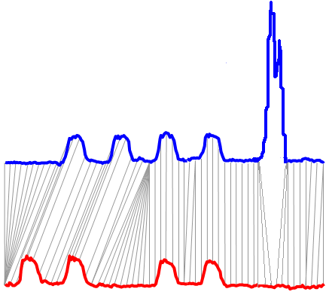
Distance Measures:
LCSS against Euclidean, DTW
Euclidean
  rigid
Dynamic Time Warping (DTW)
  allows local scaling
Longest Common SubSequence (LCSS)
  allows local scaling
  ignores outliers
Notes:
And LCSS which improves upon DTW by ignoring outliers.

Slide 24
Problem Variations
Queries
Whole matching
Entire query
Entire candidate
Subsequence matching
Entire query
A subsequence of a candidate

Slide 25
Problem Variations
Queries
Whole matching
Entire query
Entire candidate
Subsequence matching
Entire query
A subsequence of a candidate

Slide 26
Problem Variations
Queries
Nearest Neighbor (1NN)
k-Nearest Neighbor (kNN)
Farthest Neighbor
epsilon-Range
and more…

Slide 27
Similarity Matching
given a data series collection D and a query data series q, return the data series from D that are the most similar to q
  there exist different flavors of this basic operation
basis for most data series analysis tasks

Slide 28
Similarity Matching
Nearest Neighbor (NN) Search
given a data series collection D and a query data series q, return the data series from D that has the smallest distance to q
result set contains one data series

Slide 29
Similarity Matching k-Nearest Neighbors (kNN) Search
given a data series collection D and a query data series q, return the k data series from D that have the k smallest distances to q
result set contains k data series

Slide 30
Problem Variations
Queries
Nearest Neighbor (1NN)
k-Nearest Neighbor (kNN)
Farthest Neighbor
epsilon-Range
And more…

Slide 31
Nearest Neighbor (NN) Queries…
Publications
  Echihabi et al.
  PVLDB‘19

Slide 32
Nearest Neighbor (NN) Queries…
Publications
  Echihabi et al.
  PVLDB‘19
O_{Q}

Slide 33
Nearest Neighbor (NN) Queries…
Publications
  Echihabi et al.
  PVLDB‘19
Prob( d_{x} = min{d_{i}} ) = 1
result is exact NN
O_{x}
d_{x}
exact
NN
O_{Q}

Slide 34
Nearest Neighbor (NN) Queries…
Publications
  Echihabi et al.
  PVLDB‘19
Prob( d_{x} = min{d_{i}} ) = 1
result is exact NN
O_{x}
d_{x}
exact
NN
O_{Q}
Notes:
…hard, especially when this NN is in a dense area of the space

Slide 35
Nearest Neighbor (NN) Queries…
Publications
  Echihabi et al.
  PVLDB‘19
Prob( d_{x} = min{d_{i}} ) = 1
result is exact NN
O_{x}
d_{x}
exact
NN
ng-approximate
neighbors
O_{Q}
d_{ng}
Prob(d_{ng} <>= ?) = ?
result within ? of exact NN
O_{ng}

Slide 36
Nearest Neighbor (NN) Queries…
Publications
  Echihabi et al.
  PVLDB‘19
Prob(d_{ε} <= d_{x} (1+ε)) = 1
result within (1+ ε) of exact NN with probability 1
Prob( d_{x} = min{d_{i}} ) = 1
result is exact NN
ε-approximate
neighbors
O_{ε}
O_{x}
d_{x}
d_{ε}
exact
NN
d_{x} (1+ε)
ng-approximate
neighbors
O_{Q}
d_{ng}
Prob(d_{ng} <>= ?) = ?
result within ? of exact NN
O_{ng}

Slide 37
Nearest Neighbor (NN) Queries…
Publications
  Echihabi et al.
  PVLDB‘19
Prob(d_{ε} <= d_{x} (1+ε)) = 1
result within (1+ ε) of exact NN with probability 1
Prob( d_{x} = min{d_{i}} ) = 1
result is exact NN
ε-approximate
neighbors
O_{ε}
O_{x}
d_{x}
d_{ε}
exact
NN
d_{x} (1+ε)
ng-approximate
neighbors
O_{Q}
d_{ng}
Prob(d_{ng} <>= ?) = ?
result within ? of exact NN
d_{δε}
O_{ng}
O_{δε}
δ-ε-approximate
neighbor
Prob(d_{ε} <= d_{x} (1+ε)) >= δ
result within (1+ ε) of exact NN with probability at least δ

Slide 38
Nearest Neighbor (NN) Queries…
Publications
  Echihabi et al.
  PVLDB‘19
Prob(d_{ε} <= d_{x} (1+ε)) = 1
result within (1+ ε) of exact NN with probability 1
Prob( d_{x} = min{d_{i}} ) = 1
result is exact NN
ε-approximate
neighbors
O_{ε}
O_{x}
d_{x}
d_{ε}
exact
NN
d_{x} (1+ε)
ng-approximate
neighbors
O_{Q}
d_{ng}
Prob(d_{ng} <>= ?) = ?
result within ? of exact NN
d_{δε}
O_{ng}
(1+ε) r_{δ}(O_{Q})
O_{δε}
δ-ε-approximate
neighbor
Prob(d_{ε} <= d_{x} (1+ε)) >= δ
result within (1+ ε) of exact NN with probability at least δ
Notes:
The radius of the pink ribbon serves as a stopping condition. Once an algorithm thinks that it has found a point within the pink hypersphere, it stops with the probabilistic guarantee delta that this point is an epsilon-approximate neighbor

Slide 39


Query answering process
Data Loading Procedure
Query Answering Procedure
Raw data
Data Series
Database/
Indexing
Queries
Data
Answers
data-to-query time
query answering time
these times are big!

Slide 40
Query answering process
Data Loading Procedure
Query Answering Procedure
Raw data
Data Series
Database/
Indexing
Queries
Data
Answers
data-to-query time
query answering time
we need solutions
for both problems!

Slide 41
GEMINI Framework
Publications
  Faloutsos-
  SIGMOD’94
Raw data: original full-dimensional space
Summarization: reduced dimensionality space
Searching in original space costly
Searching in reduced space faster:
  Less data, indexing techniques available, lower bounding
Lower bounding enables us to
  prune search space: throw away data series based on reduced dimensionality representation
  guarantee correctness of answer
    no false negatives
    false positives filtered out based on raw data

Slide 42
Generic Search using Lower Bounding
Simplified DB
Answer
Superset
Original DB
Final Answer set
Verify against original DB
No false negatives!!
Remove false positives!!
simplified
query
query

Slide 43
GEMINI: contractiveness
Publications
  Faloutsos-
  SIGMOD’94
GEMINI works when:
D_{feature} ( F(x), F(y) ) <= D_{real} (x, y)
Note that, the closer the feature distance to the actual one, the better

Slide 44
Questions?

Slide 45
Similarity Search
Classes of Methods
Notes:
We now cover the main classes of similarity search methods for sequences

Slide 46
Similarity Search
Classes of Methods
Exact Search
Notes:
We will cover first the classes of methods that support exact search.

Slide 47
Similarity Matching
Serial Scan
Q
Q
Q
The summary of Q is compared to the summary of each candidate
Memory
Disk
C_{x}
C_{x}
C_{x}
Q is compared to each raw candidate in the dataset before returning the answer C_{x}
Q is compared to a raw candidate only if
its summary cannot be pruned
Q is compared to a raw candidate only if
its corresponding leaf cannot be pruned
(a) Serial scan
Answering a similarity search query using different access paths
Notes:
The most straightforward approach consists of performing a brute-force serial scan. Given a disk-based collection of candidate sequences shown inside the grey oval and a query sequence Q, a serial scan will read every single sequence from disk, and calculate its distance to the query and returning the candidate with the smallest distance.

Slide 48
Similarity Matching
Serial Scan
bsf = +ꝏ
Q
Q
Q
The summary of Q is compared to the summary of each candidate
Memory
Disk
C_{x}
C_{x}
C_{x}
Q is compared to each raw candidate in the dataset before returning the answer C_{x}
Q is compared to a raw candidate only if
its summary cannot be pruned
Q is compared to a raw candidate only if
its corresponding leaf cannot be pruned
(a) Serial scan
Answering a similarity search query using different access paths
Notes:
A variable called bsf, which stands for best-so-far is initialized to +inf.

Slide 49
Similarity Matching
Serial Scan
bsf = d(Q, C₁)
Q
Q
Q
The summary of Q is compared to the summary of each candidate
Memory
Disk
C_{x}
C_{x}
C_{x}
Q is compared to each raw candidate in the dataset before returning the answer C_{x}
Q is compared to a raw candidate only if
its summary cannot be pruned
Q is compared to a raw candidate only if
its corresponding leaf cannot be pruned
(a) Serial scan
Answering a similarity search query using different access paths
Notes:
The first candidate is read from disk and its distance to the query is calculated. The bsf is updated with this distance since it is certainly smaller than +inf.

Slide 50
Similarity Matching
Serial Scan
bsf = d(Q, C₁)
Q
Q
Q
The summary of Q is compared to the summary of each candidate
Memory
Disk
C_{x}
C_{x}
C_{x}
Q is compared to each raw candidate in the dataset before returning the answer C_{x}
Q is compared to a raw candidate only if
its summary cannot be pruned
Q is compared to a raw candidate only if
its corresponding leaf cannot be pruned
(a) Serial scan
Answering a similarity search query using different access paths
Notes:
The second candidate is read from disk and its distance to the query is calculated. The bsf is only updated when a better candidate is found, which is not the case here.

Slide 51
Similarity Matching
Serial Scan
bsf = d(Q, C_{x})
Q
Q
Q
The summary of Q is compared to the summary of each candidate
Memory
Disk
C_{x}
C_{x}
C_{x}
Q is compared to each raw candidate in the dataset before returning the answer C_{x}
Q is compared to a raw candidate only if
its summary cannot be pruned
Q is compared to a raw candidate only if
its corresponding leaf cannot be pruned
(a) Serial scan
Answering a similarity search query using different access paths
Notes:
The candidate C_x is the exact nearest neighbor, so its distance updates the bsf. However, search does not terminate here because we are interested in finding the exact nearest neighbor, and the algorithm does not know if a better candidate can still be found.

Slide 52
Similarity Matching
Serial Scan
bsf = d(Q, C_{x})
Q
Q
Q
The summary of Q is compared to the summary of each candidate
Memory
Disk
C_{x}
C_{x}
C_{x}
Q is compared to each raw candidate in the dataset before returning the answer C_{x}
Q is compared to a raw candidate only if
its summary cannot be pruned
Q is compared to a raw candidate only if
its corresponding leaf cannot be pruned
(a) Serial scan
Answering a similarity search query using different access paths
Notes:
So, it processes the full dataset

Slide 53
Similarity Matching
Serial Scan
Q
Q
Q
Memory
Disk
C_{x}
C_{x}
C_{x}
Q is compared to each raw candidate in the dataset before returning the answer C_{x}
Q is compared to a raw candidate only if
its corresponding leaf cannot be pruned
(a) Serial scan
(b) Skip-sequential scan
Answering a similarity search query using different access paths
Notes:
Returning C_x as the exact nearest neighbor.

Slide 54


Similarity Matching
Serial Scan
Q
Q
Q
Memory
Disk
C_{x}
C_{x}
C_{x}
Q is compared to each raw candidate in the dataset before returning the answer C_{x}
Q is compared to a raw candidate only if
its corresponding leaf cannot be pruned
(a) Serial scan
(b) Skip-sequential scan
Answering a similarity search query using different access paths
Notes:
As you can see, such an approach can be extremely slow particularly when dealing with massive collections because every single candidate has to be read and processed.

Slide 55
Indexes vs. Scans
Q
Q
Q
Memory
Disk
C_{x}
C_{x}
C_{x}
Q is compared to each raw candidate in the dataset before returning the answer C_{x}
Q is compared to a raw candidate only if
its corresponding leaf cannot be pruned
(a) Serial scan
(b) Skip-sequential scan
Answering a similarity search query using different access paths
Notes:
That is why, alternative classes of methods were proposed. The first one is based on a skip-sequential scan. Such techniques aim at reducing the number of candidates that are read and processed.

Slide 56
Indexes vs. Scans
Q
Q
Q
Memory
Disk
C_{x}
C_{x}
C_{x}
Q is compared to each raw candidate in the dataset before returning the answer C_{x}
Q is compared to a raw candidate only if
its corresponding leaf cannot be pruned
(a) Serial scan
(b) Skip-sequential scan
Answering a similarity search query using different access paths
Notes:
First, the dataset is summarized such that the summaries can fit in memory. We show the summaries as green points in the small grey oval.

Slide 57
Indexes vs. Scans
bsf = +ꝏ
lb_{cur} = +ꝏ
Q
Q
Q
lower-bounding (lb) property:
d_{lb}(Q’, C_{i}’) <= d(Q, C_{i})
Memory
Disk
C_{x}
C_{x}
C_{x}
Q is compared to each raw candidate in the dataset before returning the answer C_{x}
Q is compared to a raw candidate only if
its corresponding leaf cannot be pruned
(a) Serial scan
(b) Skip-sequential scan
Answering a similarity search query using different access paths
Notes:
In line with the ideas proposed in the GEMINI framework, to guarantee correctness of exact similarity search, the summarization chosen has to support the lower-bounding property, which guarantees that the distance of any two points in the high-dimensional space is guaranteed to be greater than or equal to the distance between their summaries in the lower-dimensional space. We refer to candidates with C and their summaries as C’. The variable bsf will keep track of the distance to the best-so-far answer and the second variable stores the current lower-bounding distance calculated.

Slide 58
Indexes vs. Scans
bsf = +ꝏ
lb_{cur} = d_{lb}(Q’,C₁’)
Q
Q
Q
The summary of Q (Q’) is compared to the summary of each candidate
Memory
Disk
C_{x}
C_{x}
C_{x}
Q is compared to each raw candidate in the dataset before returning the answer C_{x}
Q is compared to a raw candidate only if
its corresponding leaf cannot be pruned
(a) Serial scan
(b) Skip-sequential scan
Answering a similarity search query using different access paths
Notes:
We calculate the distance between the summary of Q and the summary of C1.

Slide 59
Indexes vs. Scans
bsf = +ꝏ
lb_{cur} = d_{lb}(Q’,C₁’) < bsf
Q
Q
Q
The summary of Q (Q’) is compared to the summary of each candidate
Memory
Disk
C_{x}
C_{x}
C_{x}
Q is compared to each raw candidate in the dataset before returning the answer C_{x}
Q is compared to a raw candidate only if
its corresponding leaf cannot be pruned
(a) Serial scan
(b) Skip-sequential scan
Answering a similarity search query using different access paths
Notes:
The lb-dist is not greater than +inf, so C1 cannot be pruned

Slide 60
Indexes vs. Scans
bsf = +ꝏ
lb_{cur} = d_{lb}(Q’,C₁’) < bsf
Q
Q
Q
The summary of Q (Q’) is compared to the summary of each candidate
Memory
Disk
C_{x}
C_{x}
C_{x}
Q is compared to each raw candidate in the dataset before returning the answer C_{x}
Q is compared to a raw candidate only if
its summary cannot be pruned
Q is compared to a raw candidate only if
its corresponding leaf cannot be pruned
(a) Serial scan
(b) Skip-sequential scan
Answering a similarity search query using different access paths
Notes:
It is read from disk and its distance to Q is calculated

Slide 61
Indexes vs. Scans
bsf = d(Q,C₁)
lb_{cur} = d_{lb}(Q’,C₁’) < bsf
Q
Q
Q
The summary of Q (Q’) is compared to the summary of each candidate
Memory
Disk
C_{x}
C_{x}
C_{x}
Q is compared to each raw candidate in the dataset before returning the answer C_{x}
Q is compared to a raw candidate only if
its summary cannot be pruned
Q is compared to a raw candidate only if
its corresponding leaf cannot be pruned
(a) Serial scan
(b) Skip-sequential scan
Answering a similarity search query using different access paths
Notes:
And the bsf is updated

Slide 62
Indexes vs. Scans
bsf = d(Q,C₁)
lb_{cur} = d_{lb}(Q’,C₂’)
Q
Q
Q
The summary of Q (Q’) is compared to the summary of each candidate
Memory
Disk
C_{x}
C_{x}
C_{x}
Q is compared to each raw candidate in the dataset before returning the answer C_{x}
Q is compared to a raw candidate only if
its summary cannot be pruned
Q is compared to a raw candidate only if
its corresponding leaf cannot be pruned
(a) Serial scan
(b) Skip-sequential scan
Answering a similarity search query using different access paths
Notes:
The second summary is read in-memory, its distance to Q’ calculated

Slide 63
Indexes vs. Scans
bsf = d(Q,C₁)
lb_{cur} = d_{lb}(Q’,C₂’) >= bsf
Q
Q
Q
The summary of Q (Q’) is compared to the summary of each candidate
Memory
Disk
C_{x}
C_{x}
C_{x}
Q is compared to each raw candidate in the dataset before returning the answer C_{x}
Q is compared to a raw candidate only if
its summary cannot be pruned
Q is compared to a raw candidate only if
its corresponding leaf cannot be pruned
(a) Serial scan
(b) Skip-sequential scan
Answering a similarity search query using different access paths
Notes:
The lb-distance is found to be >= bsf,

Slide 64
Indexes vs. Scans
bsf = d(Q,C₁)
lb_{cur} = d_{lb}(Q’,C₂’) >= bsf
d(Q,C₂) >=
Q
LB Property
Q
Q
The summary of Q (Q’) is compared to the summary of each candidate
Memory
Disk
C_{x}
C_{x}
C_{x}
Q is compared to each raw candidate in the dataset before returning the answer C_{x}
Q is compared to a raw candidate only if
its summary cannot be pruned
Q is compared to a raw candidate only if
its corresponding leaf cannot be pruned
(a) Serial scan
(b) Skip-sequential scan
Answering a similarity search query using different access paths
Notes:
According to the lb property, the distance in the high-d space will also be greater than bsf

Slide 65
Indexes vs. Scans
bsf = d(Q,C₁)
lb_{cur} = d_{lb}(Q’,C₂’) >= bsf
d(Q,C₂) >=
Q
LB Property
Q
Q
The summary of Q (Q’) is compared to the summary of each candidate
prune C₂
Memory
Disk
C_{x}
C_{x}
C_{x}
Q is compared to each raw candidate in the dataset before returning the answer C_{x}
Q is compared to a raw candidate only if
its summary cannot be pruned
Q is compared to a raw candidate only if
its corresponding leaf cannot be pruned
(a) Serial scan
(b) Skip-sequential scan
Answering a similarity search query using different access paths
Notes:
So C2 can be pruned

Slide 66
Indexes vs. Scans
bsf = d(Q,C₁)
lb_{cur} = d_{lb}(Q’,C_{x}’)
Q
Q
Q
The summary of Q (Q’) is compared to the summary of each candidate
Memory
Disk
C_{x}
C_{x}
C_{x}
Q is compared to each raw candidate in the dataset before returning the answer C_{x}
Q is compared to a raw candidate only if
its summary cannot be pruned
Q is compared to a raw candidate only if
its corresponding leaf cannot be pruned
(a) Serial scan
(b) Skip-sequential scan
Answering a similarity search query using different access paths
Notes:
We proceed similarity checking summaries until we get to C_x

Slide 67
Indexes vs. Scans
bsf = d(Q,C₁)
lb_{cur} = d_{lb}(Q’,C_{x}’) < bsf
Q
Q
Q
The summary of Q (Q’) is compared to the summary of each candidate
Memory
Disk
C_{x}
C_{x}
C_{x}
Q is compared to each raw candidate in the dataset before returning the answer C_{x}
Q is compared to a raw candidate only if
its summary cannot be pruned
Q is compared to a raw candidate only if
its corresponding leaf cannot be pruned
(a) Serial scan
(b) Skip-sequential scan
Answering a similarity search query using different access paths
Notes:
The lb-distance is found to be smaller than the bsf

Slide 68
Indexes vs. Scans
bsf = d(Q,C_{x})
lb_{cur} = d_{lb}(Q’,C_{x}’) < bsf
Q
Q
Q
The summary of Q (Q’) is compared to the summary of each candidate
Memory
Disk
C_{x}
C_{x}
C_{x}
Q is compared to each raw candidate in the dataset before returning the answer C_{x}
Q is compared to a raw candidate only if
its summary cannot be pruned
Q is compared to a raw candidate only if
its corresponding leaf cannot be pruned
(a) Serial scan
(b) Skip-sequential scan
Answering a similarity search query using different access paths
Notes:
So C_x cannot be pruned, its distance is calculated and the bsf is updated

Slide 69
Indexes vs. Scans
bsf = d(Q,C_{x})
lb_{cur} = d_{lb}(Q’,C_{n}’) < bsf
Q
Q
Q
The summary of Q (Q’) is compared to the summary of each candidate
Memory
Disk
C_{x}
C_{x}
C_{x}
Q is compared to each raw candidate in the dataset before returning the answer C_{x}
Q is compared to a raw candidate only if
its summary cannot be pruned
Q is compared to a raw candidate only if
its corresponding leaf cannot be pruned
(a) Serial scan
(b) Skip-sequential scan
Answering a similarity search query using different access paths
Notes:
We continue until all summaries have been processed.

Slide 70
Indexes vs. Scans
Q
Q
Q
The summary of Q (Q’) is compared to the summary of each candidate
Memory
Disk
C_{x}
C_{x}
C_{x}
Q is compared to each raw candidate in the dataset before returning the answer C_{x}
Q is compared to a raw candidate only if
its summary cannot be pruned
Q is compared to a raw candidate only if
its corresponding leaf cannot be pruned
(a) Serial scan
(b) Skip-sequential scan
Answering a similarity search query using different access paths
Notes:
And the candidate with the smallest distance to Q is returned.
Observe that in the case of a serial scan, all candidates in the high-d space are processed and in the case of a skip-sequential scan, all the points in the summarized space are processed.

Slide 71
Indexes vs. Scans
Q
Q
Q
The summary of Q (Q’) is compared to the summary of each candidate
1
2
3
4
5
Memory
1
2
Disk
C_{x}
C_{x}
C_{x}
Q is compared to each raw candidate in the dataset before returning the answer C_{x}
Q is compared to a raw candidate only if
its summary cannot be pruned
(a) Serial scan
(b) Skip-sequential scan
(c) Tree-based index
Answering a similarity search query using different access paths
Notes:
Another class of methods based on trees aims at improving upon this last point by reducing the number of point processed in the summarized space. So, it organizes the summaries in a tree-based data structure, which is not necessarily binary. In the figure to the right, we show internal nodes in green, leaf nodes in blue and subtrees in light blue. Each internal node summarizes the data stored in the subtree rooted at this node and the leaf nodes store the actual sequences.

Slide 72
Indexes vs. Scans
bsf = +ꝏ
Q
Q
Q
The summary of Q (Q’) is compared to the summary of each candidate
1
2
3
4
5
Memory
1
2
Disk
C_{x}
C_{x}
C_{x}
Q is compared to each raw candidate in the dataset before returning the answer C_{x}
Q is compared to a raw candidate only if
its summary cannot be pruned
(a) Serial scan
(b) Skip-sequential scan
(c) Tree-based index
Answering a similarity search query using different access paths
Notes:
A bsf is initialized to +inf

Slide 73
Indexes vs. Scans
bsf = +ꝏ
Q
Q
Q
The summary of Q (Q’) is compared to the summary of each candidate
1
2
3
4
5
Memory
1
2
Disk
C_{x}
C_{x}
C_{x}
Q is compared to each raw candidate in the dataset before returning the answer C_{x}
Q is compared to a raw candidate only if
its summary cannot be pruned
(a) Serial scan
(b) Skip-sequential scan
(c) Tree-based index
Answering a similarity search query using different access paths
Notes:
A first approximate answer is found heuristically by traversing one path in the index tree

Slide 74
Indexes vs. Scans
bsf = d(Q,C₃)
Q
Q
Q
The summary of Q (Q’) is compared to the summary of each candidate
1
2
3
4
5
Memory
1
2
Disk
C_{x}
C_{x}
C_{x}
Q is compared to each raw candidate in the dataset before returning the answer C_{x}
Q is compared to a raw candidate only if
its summary cannot be pruned
(a) Serial scan
(b) Skip-sequential scan
(c) Tree-based index
Answering a similarity search query using different access paths
Notes:
and setting bsf to the smallest distance between Q and the candidates belonging to the visited leaf.

Slide 75
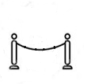
Indexes vs. Scans
1
bsf = d(Q,C₃)
Queue
Q
Q
Q
The summary of Q (Q’) is compared to the summary of each candidate
1
2
3
4
5
Memory
1
2
Disk
C_{x}
C_{x}
C_{x}
Q is compared to each raw candidate in the dataset before returning the answer C_{x}
Q is compared to a raw candidate only if
its summary cannot be pruned
(a) Serial scan
(b) Skip-sequential scan
(c) Tree-based index
Answering a similarity search query using different access paths
Notes:
A priority queue is initialized with the root of the tree. Nodes with lower lb-distances to the query have higher priority.

Slide 76
Indexes vs. Scans
bsf = d(Q,C₃)
lb_{cur} = d_{lb}(Q’, )
Queue
Queue
1
Q
Q
Q
The summary of Q (Q’) is compared to the summary of each candidate
1
2
3
4
5
Memory
1
2
Disk
C_{x}
C_{x}
C_{x}
Q is compared to each raw candidate in the dataset before returning the answer C_{x}
Q is compared to a raw candidate only if
its summary cannot be pruned
(a) Serial scan
(b) Skip-sequential scan
(c) Tree-based index
Answering a similarity search query using different access paths
Notes:
The node with the highest priority is dequeued and its lb-disstane is compared to bsf

Slide 77
Indexes vs. Scans
bsf = d(Q,C₃)
lb_{cur} = d_{lb}(Q’, ) < bsf
Queue
Queue
1
Q
Q
Q
The summary of Q (Q’) is compared to the summary of each candidate
1
2
3
4
5
Memory
1
2
Disk
C_{x}
C_{x}
C_{x}
Q is compared to each raw candidate in the dataset before returning the answer C_{x}
Q is compared to a raw candidate only if
its summary cannot be pruned
(a) Serial scan
(b) Skip-sequential scan
(c) Tree-based index
Answering a similarity search query using different access paths
Notes:
If smaller, then the node cannot be pruned

Slide 78
Indexes vs. Scans
3
2
bsf = d(Q,C₃)
lb_{cur} = d_{lb}(Q’, ) < bsf
Queue
Queue
1
Q
Q
Q
The summary of Q (Q’) is compared to the summary of each candidate
1
2
3
4
5
Memory
1
2
Disk
C_{x}
C_{x}
C_{x}
Q is compared to each raw candidate in the dataset before returning the answer C_{x}
Q is compared to a raw candidate only if
its summary cannot be pruned
(a) Serial scan
(b) Skip-sequential scan
(c) Tree-based index
Answering a similarity search query using different access paths
Notes:
Its children nodes are added to the pqueue.

Slide 79
Indexes vs. Scans
3
bsf = d(Q,C₃)
lb_{cur} = d_{lb}(Q’, )
Queue
2
Q
Q
Q
The summary of Q (Q’) is compared to the summary of each candidate
1
2
3
4
5
Memory
1
2
Disk
C_{x}
C_{x}
C_{x}
Q is compared to each raw candidate in the dataset before returning the answer C_{x}
Q is compared to a raw candidate only if
its summary cannot be pruned
(a) Serial scan
(b) Skip-sequential scan
(c) Tree-based index
Answering a similarity search query using different access paths
Notes:
Node 2 is now dequeued

Slide 80
Indexes vs. Scans
3
bsf = d(Q,C₃)
lb_{cur} = d_{lb}(Q’, ) < bsf
Queue
2
Q
Q
Q
The summary of Q (Q’) is compared to the summary of each candidate
1
2
3
4
5
Memory
1
2
Disk
C_{x}
C_{x}
C_{x}
Q is compared to each raw candidate in the dataset before returning the answer C_{x}
Q is compared to a raw candidate only if
its summary cannot be pruned
(a) Serial scan
(b) Skip-sequential scan
(c) Tree-based index
Answering a similarity search query using different access paths
Notes:
It cannot be pruned

Slide 81
Indexes vs. Scans
3
4
5
bsf = d(Q,C₃)
lb_{cur} = d_{lb}(Q’, ) < bsf
Queue
2
Q
Q
Q
The summary of Q (Q’) is compared to the summary of each candidate
1
2
3
4
5
Memory
1
2
Disk
C_{x}
C_{x}
C_{x}
Q is compared to each raw candidate in the dataset before returning the answer C_{x}
Q is compared to a raw candidate only if
its summary cannot be pruned
(a) Serial scan
(b) Skip-sequential scan
(c) Tree-based index
Answering a similarity search query using different access paths
Notes:
So, its children nodes are added to the pqueue

Slide 82
Indexes vs. Scans
3
4
bsf = d(Q,C₃)
lb_{cur} = d_{lb}(Q’, )
Queue
5
Q
Q
Q
The summary of Q (Q’) is compared to the summary of each candidate
1
2
3
4
5
Memory
1
2
Disk
C_{x}
C_{x}
C_{x}
Q is compared to each raw candidate in the dataset before returning the answer C_{x}
Q is compared to a raw candidate only if
its summary cannot be pruned
(a) Serial scan
(b) Skip-sequential scan
(c) Tree-based index
Answering a similarity search query using different access paths
Notes:
Node 5 is now dequeued

Slide 83
Indexes vs. Scans
3
4
bsf = d(Q,C₃)
lb_{cur} = d_{lb}(Q’, ) < bsf
Queue
5
Q
Q
Q
The summary of Q (Q’) is compared to the summary of each candidate
1
2
3
4
5
Memory
1
2
Disk
C_{x}
C_{x}
C_{x}
Q is compared to each raw candidate in the dataset before returning the answer C_{x}
Q is compared to a raw candidate only if
its summary cannot be pruned
(a) Serial scan
(b) Skip-sequential scan
(c) Tree-based index
Answering a similarity search query using different access paths
Notes:
And cannot be pruned

Slide 84
Indexes vs. Scans
3
4
2
bsf = d(Q,C₃)
lb_{cur} = d_{lb}(Q’, ) < bsf
Queue
5
Q
Q
Q
The summary of Q (Q’) is compared to the summary of each candidate
1
2
3
4
5
Memory
1
2
Disk
C_{x}
C_{x}
C_{x}
Q is compared to each raw candidate in the dataset before returning the answer C_{x}
Q is compared to a raw candidate only if
its summary cannot be pruned
(a) Serial scan
(b) Skip-sequential scan
(c) Tree-based index
Answering a similarity search query using different access paths
Notes:
So, its children are enqueued

Slide 85
Indexes vs. Scans
3
4
bsf = d(Q,C₃)
lb_{cur} = d_{lb}(Q’, )
Queue
2
Q
Q
Q
The summary of Q (Q’) is compared to the summary of each candidate
1
2
3
4
5
Memory
1
2
Disk
C_{x}
C_{x}
C_{x}
Q is compared to each raw candidate in the dataset before returning the answer C_{x}
Q is compared to a raw candidate only if
its summary cannot be pruned
(a) Serial scan
(b) Skip-sequential scan
(c) Tree-based index
Answering a similarity search query using different access paths
Notes:
LeafNode 2 is now processed

Slide 86
Indexes vs. Scans
3
4
bsf = d(Q,C₃)
lb_{cur} = d_{lb}(Q’, ) < bsf
Queue
2
Q
Q
Q
The summary of Q (Q’) is compared to the summary of each candidate
1
2
3
4
5
Memory
1
2
Disk
C_{x}
C_{x}
C_{x}
Q is compared to each raw candidate in the dataset before returning the answer C_{x}
Q is compared to a raw candidate only if
its summary cannot be pruned
(a) Serial scan
(b) Skip-sequential scan
(c) Tree-based index
Answering a similarity search query using different access paths
Notes:
It cannot be pruned

Slide 87
Indexes vs. Scans
3
4
bsf = d(Q,C₃)
lb_{cur} = d_{lb}(Q’, ) < bsf
Queue
2
Q
Q
Q
The summary of Q (Q’) is compared to the summary of each candidate
1
2
3
4
5
Memory
1
2
Disk
C_{x}
C_{x}
C_{x}
Q is compared to each raw candidate in the dataset before returning the answer C_{x}
Q is compared to a raw candidate only if
its summary cannot be pruned
(a) Serial scan
(b) Skip-sequential scan
(c) Tree-based index
Answering a similarity search query using different access paths
Notes:
So all the sequences that belong to it are read from disk and their distances to Q calculated.

Slide 88
Indexes vs. Scans
3
4
bsf = d(Q,C_{x})
lb_{cur} = d_{lb}(Q’, ) < bsf
Queue
2
Q
Q
Q
The summary of Q (Q’) is compared to the summary of each candidate
1
2
3
4
5
Memory
1
2
Disk
C_{x}
C_{x}
C_{x}
Q is compared to each raw candidate in the dataset before returning the answer C_{x}
Q is compared to a raw candidate only if
its summary cannot be pruned
(a) Serial scan
(b) Skip-sequential scan
(c) Tree-based index
Answering a similarity search query using different access paths
Notes:
The bsf is updated with the smallest distance

Slide 89
Indexes vs. Scans
3
bsf = d(Q,C_{x})
lb_{cur} = d_{lb}(Q’, )
Queue
4
Q
Q
Q
The summary of Q (Q’) is compared to the summary of each candidate
1
2
3
4
5
Memory
1
2
Disk
C_{x}
C_{x}
C_{x}
Q is compared to each raw candidate in the dataset before returning the answer C_{x}
Q is compared to a raw candidate only if
its summary cannot be pruned
(a) Serial scan
(b) Skip-sequential scan
(c) Tree-based index
Answering a similarity search query using different access paths
Notes:
Node 4 is processed next

Slide 90
Indexes vs. Scans
3
bsf = d(Q,C_{x})
lb_{cur} = d_{lb}(Q’, ) > bsf
Queue
4
Q
Q
Q
LB Property
The summary of Q (Q’) is compared to the summary of each candidate
1
prune
4
2
3
4
5
Memory
1
2
Disk
C_{x}
C_{x}
C_{x}
Q is compared to each raw candidate in the dataset before returning the answer C_{x}
Q is compared to a raw candidate only if
its summary cannot be pruned
(a) Serial scan
(b) Skip-sequential scan
(c) Tree-based index
Answering a similarity search query using different access paths
Notes:
Its lb-distance is greater than the bsf, so according to the lb property, this node can be pruned

Slide 91

Indexes vs. Scans
3
bsf = d(Q,C_{x})
lb_{cur} = d_{lb}(Q’, ) > bsf
Queue
4
Q
Q
Q
The summary of Q (Q’) is compared to the summary of each candidate
1
2
3
4
5
Memory
1
2
Disk
C_{x}
C_{x}
C_{x}
Q is compared to each raw candidate in the dataset before returning the answer C_{x}
Q is compared to a raw candidate only if
its summary cannot be pruned
(a) Serial scan
(b) Skip-sequential scan
(c) Tree-based index
Answering a similarity search query using different access paths
Notes:
In fact, search can terminate even if there are still some elements in the priority queue because all of these elements have an lb-distance that is bigger than the lb-distance of Node 4, and thus are greater than bsf. So they can be safely pruned.

Slide 92
Indexes vs. Scans
3
bsf = d(Q,C_{x})
lb_{cur} = d_{lb}(Q’, ) > bsf
Queue
4
Q
Q
Q
The summary of Q (Q’) is compared to the summary of each candidate
1
2
3
4
5
Memory
1
2
Disk
C_{x}
C_{x}
C_{x}
Q is compared to each raw candidate in the dataset before returning the answer C_{x}
Q is compared to a raw candidate only if
its summary cannot be pruned
(a) Serial scan
(b) Skip-sequential scan
(c) Tree-based index
Answering a similarity search query using different access paths
Notes:
And the candidate with the smallest distance to Q is returned.

Slide 93
Similarity Search
Data Series Extensions
Approximate Search
Notes:
We covered the main classes of methods that support exact similarity search for sequences. We now cover a new set of techniques that support all flavors of search: exact, ng-approximate, e-approximate and de-approximate.

Slide 94

Publications
  Echihabi-PVLDB‘19
Access Paths
O_{Q}
O_{Q}
O_{Q}
The summary of O_{Q} (O_{Q}’) is compared to the summary of each candidate
1
2
3
4
Memory
1
2
Disk
O_{x}
O_{x}
O_{x}
O_{Q} is compared to each raw candidate in the dataset before returning the answer O_{x}
O_{Q} is compared to a raw candidate only if
its summary cannot be pruned
(a) Serial scan
(b) Skip-sequential scan
(c) Tree-based index
Answering a similarity search query using different access paths
Notes:
These techniques extend existing data series approaches that perform exact search in particular ski-sequential and tree-based indexes.

Slide 95
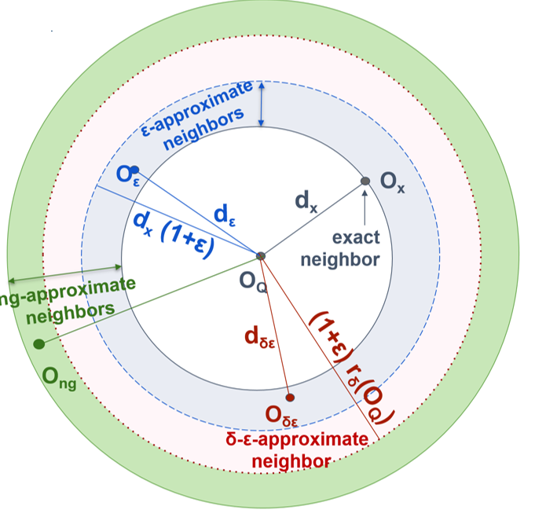
Publications
  Echihabi-PVLDB‘19
Extensions: Skip-Sequential Scans
bsf = d(O_{Q},O₁)
lb_{cur} = d_{lb}(O_{Q}’, O_{x}’) < bsf
P{d_{ε} <= d_{x} (1+ε)} >= δ
Result is within
distance (1+ ε) of
the exact answer with probability at least δ
O_{Q}
The summary of O_{Q} (O_{Q}’) is compared to the summary of each candidate
Memory
Disk
O_{x}
Notes:
Let’s look briefly at hoe these extensions work. Recall that an e-approximate neighbor is one that is guaranteed to fall in the blue donut, that is its distance to Q is smaller than or equal to (1+e) dx, dx is the distance to the exact neighbor.

Slide 96
Publications
  Echihabi-PVLDB‘19
Extensions: Skip-Sequential Scans
bsf = d(O_{Q},O₁)
lb_{cur} = d_{lb}(O_{Q}’, O_{x}’) < bsf
lb_{cur} = d_{lb}(O_{Q}’, O_{x}’) < bsf / (1+ε)
P{d_{ε} <= d_{x} (1+ε)} >= δ
Result is within
distance (1+ ε) of
the exact answer with probability at least δ
O_{Q}
The summary of O_{Q} (O_{Q}’) is compared to the summary of each candidate
Memory
Disk
O_{x}
Notes:
The (1+e) term is exploited in the comparison of the lb-distance to the bsf to be able to prune more points.

Slide 97
If d_{lb}(O_{Q}’, O_{x}’) >= bsf / (1+ε)
Then bsf <= d(O_{Q}, O_{x}) (1+ε)
i.e., bsf <= d_{x} (1+ε)
Publications
  Echihabi-PVLDB‘19
Extensions: Skip-Sequential Scans
bsf = d(O_{Q},O₁)
lb_{cur} = d_{lb}(O_{Q}’, O_{x}’) < bsf
lb_{cur} = d_{lb}(O_{Q}’, O_{x}’) < bsf / (1+ε)
P{d_{ε} <= d_{x} (1+ε)} >= δ
Result is within
distance (1+ ε) of
the exact answer with probability at least δ
O_{Q}
The summary of O_{Q} (O_{Q}’) is compared to the summary of each candidate
Memory
Disk
O_{x}

Slide 98

Publications
  Echihabi-PVLDB‘19
Extensions: Skip-Sequential Scans
bsf = d(O_{Q},O₁)
If bsf <=
(1+ε) r_{δ}(O_{Q})
P{d_{ε} <= d_{x} (1+ε)} >= δ
Result is within
distance (1+ ε) of
the exact answer
with probability at
least δ
O_{Q}
The summary of O_{Q} (O_{Q}’) is compared to the summary of each candidate
Memory
Disk
O_{x}
Notes:
And recall that a d-e-approximate neighbor is one that is e-approximate with guarantee at least delta. The delta is used to find the radius of the pink ribbon. Then this radius is used as a stopping condition. When the algorithm finds a candidate inside the pink ribbon it can safely stop guaranteeing that this neighbor is e-approximate.
We showed how extensions support e-approximate and d-e-approximate search for skip-sequential scans. Ng-approximate search consists of adding a parameter that informs the skip-sequential scan about the maximum number of summaries that it can process.

Slide 99
Publications
  Echihabi-PVLDB‘19
Extensions: Skip-Sequential Scans
bsf = d(O_{Q},O₁)
If bsf <=
(1+ε) r_{δ}(O_{Q})
P{d_{ε} <= d_{x} (1+ε)} >= δ
Result is within
distance (1+ ε) of
the exact answer
with probability at
least δ
O_{Q}
The summary of O_{Q} (O_{Q}’) is compared to the summary of each candidate
Memory
Disk
O_{x}
If bsf <= (1+ε) r_{δ}(O_{Q})
Given that P{d_{x} > r_{δ}(O_{Q})} >= δ, i.e, P{d_{x} <= r_{δ}(O_{Q})} < 1-δ
And bsf / (1+ε) <= r_{δ}(O_{Q}) Then P{d_{x} <= bsf / (1+ε)} < 1-δ *
So P{d_{x} > bsf / (1+ε)} >= δ., i.e., P{bsf < (1+ε) d_{x})} >= δ
* We assume the monotonicity of the distribution of nearest neighbors of O_{Q}

Slide 100
Publications
  Echihabi-PVLDB‘19
Extensions: Tree Indexes
bsf = d(O_{Q},O₃)
lb_{cur} = d_{lb}(O_{Q}’, ) < bsf
1
P{d_{ε} <= d_{x} (1+ε)} >= δ
Result is within
distance (1+ ε) of
the exact answer with probability at least δ
Q
1
2
3
4
Memory
1
2
Disk
O_{x}
Notes:
We follow the same ideas for indexes.

Slide 101
Publications
  Echihabi-PVLDB‘19
Extensions: Tree Indexes
bsf = d(O_{Q},O₃)
lb_{cur} = d_{lb}(O_{Q}’, ) < bsf
lb_{cur} = d_{lb}(O_{Q}’, ) < bsf / (1+ε)
1
Q
1
P{d_{ε} <= d_{x} (1+ε)} >= δ
Result is within
distance (1+ ε) of
the exact answer with probability at least δ
1
2
3
4
Memory
1
2
Disk
O_{x}
Notes:
The 1+e factor is used to prune out more nodes

Slide 102
Publications
  Echihabi-PVLDB‘19
Extensions: Tree Indexes
bsf = d(O_{Q},O₃)
If bsf <=
(1+ε) r_{δ}(O_{Q})
P{d_{ε} <= d_{x} (1+ε)} >= δ
Result is within
distance (1+ ε) of
the exact answer
with probability at
least δ
Q
1
2
3
4
Memory
1
2
Disk
O_{x}
Notes:
And the delta is used to find the stopping condition.
We showed how extensions support e-approximate and d-e-approximate search for tree-based indexes. Ng-approximate search consists of adding a parameter that informs the index about the maximum number of leaves that it can visit.

Slide 103
Methods
Publications
  Echihabi-PVLDB‘18
Techniques for data Series
Techniques for High-D vectors
  Echihabi-PVLDB‘19
Similarity Search Methods
0 ⩽ δ ⩽ 1, ε ⩾ 0
δ,ε guarantees
No guarantees
δ-ε-Approximate*
ng-Approximate
δ < 1, ε guarantee
δ = 1, ε guarantee
ADS+ IMI
CK-Means iSAX2+[ ]
DSTree [ ] NSG
Flann SFA
HD-index VA+file[ ]
HNSW
Probabilistic
ε-Approximate
δ = 1, ε = 0 guarantee
ADS+[ ]
DSTree[ ]
iSAX2+ [ ]
Mtree
QALSH
SRS
VA+file[ ]
ADS+[ ]
DSTree[ ]
iSAX2+ [ ]
Mtree
VA+file[ ]
Exact
ADS+ RTree
DSTree SFA
iSAX2+ Stepwise Mtree UCR-Suite
MASS VA+file
* result is within distance
(1+ ε) of the exact answer
with probability δ
extensions
Notes:
A taxonomy was proposed to classify the different state-of-the-art methods according to the type of search they support and the next section will cover some of them in more detail.

Slide 104
Questions?

Slide 105
Data Series Indexing

Slide 106
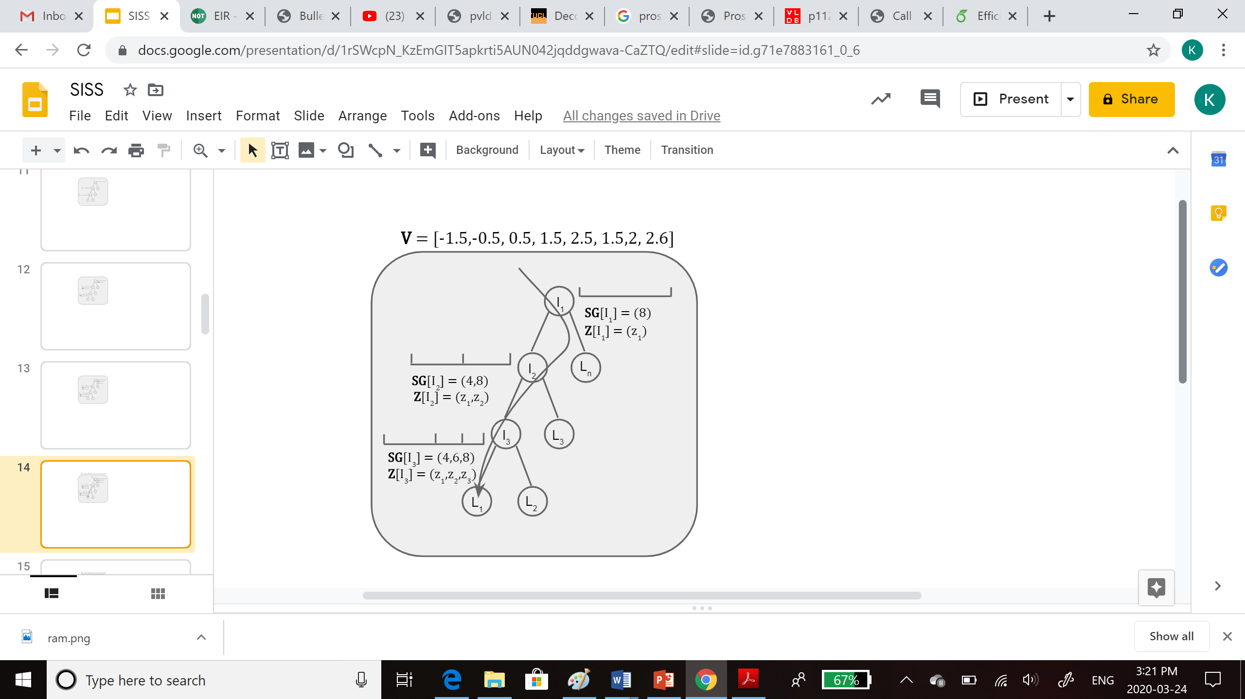
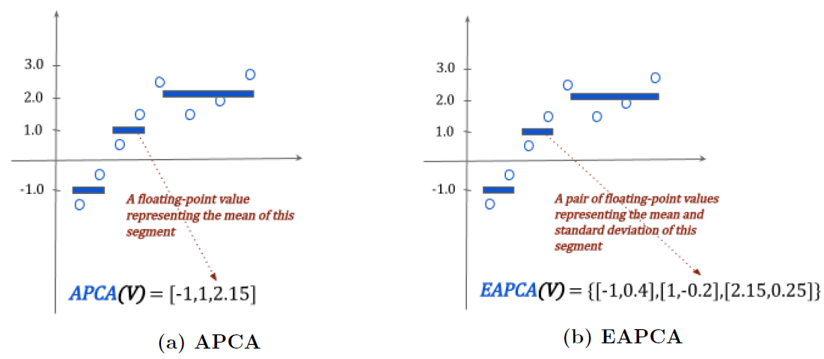
DSTree
Summarization
Publications
  Wang-PVLDB‘13
Intertwined with indexing
The APCA and EAPCA representations

Slide 107
DSTree
Indexing
Publications
  Wang-PVLDB‘13
Each node contains
# vectors
segmentation SG
synopsis Z
Each Leaf node also :
stores its raw
vectors in a separate
disk file

Slide 108
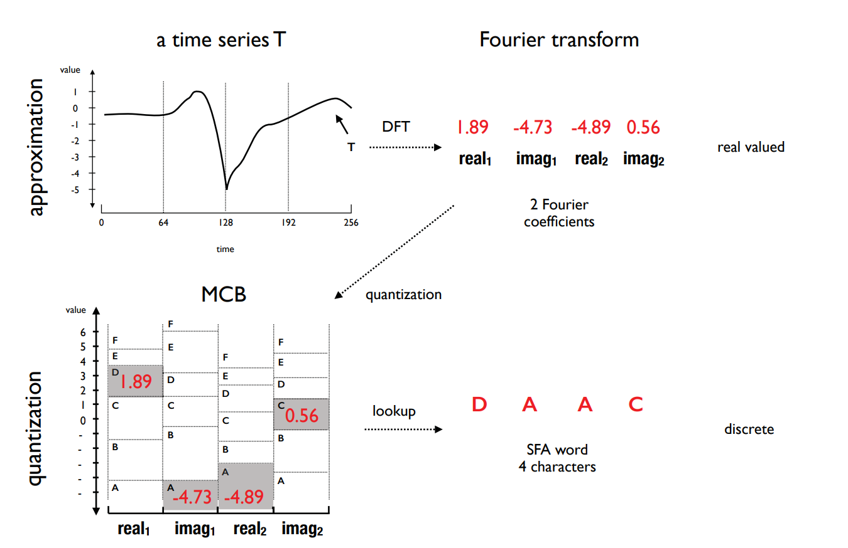
Symbolic Fourier Approximation (SFA)
Summarization
Publications
  Schafer-EDBT‘12
The SFA representation*
*https://www2.informatik.hu-berlin.de/~schaefpa/talks/scalable_classification.pptx
Notes:
The symbolic time series representation Symbolic Fourier Approximation (SFA) represents each real-valued time series by a string. SFA is composed of approximation using the Fourier transform and quantization using a technique called Multiple Coefficient Binning (MCB)

Slide 109
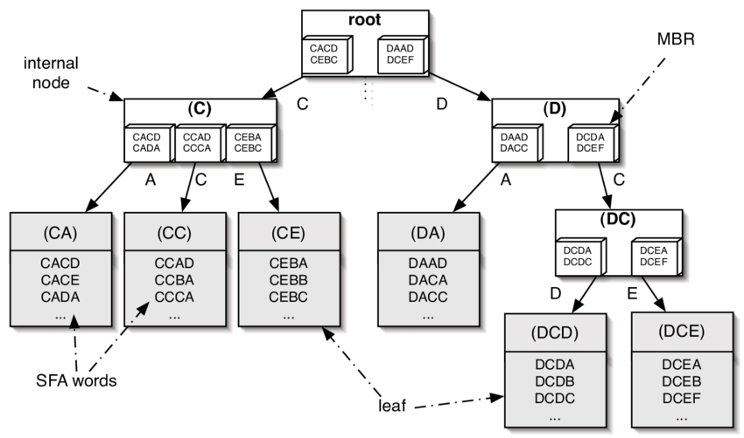
SFA
Indexing
Publications
  Schafer-EDBT‘12
The SFA Trie*
*https://www2.informatik.hu-berlin.de/~schaefpa/talks/scalable_classification.pptx
Notes:
Since symbolic representations are essentially a character string, they can be used with string algorithms and data structures such prefix tries, bag-of-words, Markov models, or string-matching.

Slide 110
iSAX Family iSAX Summarization
Publications
  Shieh-
  KDD‘08
based on iSAX representation, which offers a bit-aware, quantized, multi-resolution representation with variable granularity
3
2
PAA(T,4)
1
0
= {110 ,110 ,0111 ,000} = {11 ,11 ,011 ,00 } = {1 ,1 ,0 ,0 }
-1
-2
-3
0
4
8
12
16
3
2
iSAX(T,4,4)
1
00
01
0
10
-1
11
-2
-3
0
4
8
12
16
Notes:
The isax-based indexes use the isax summarization that we described earlier.
As we mentioned, the isax summarization is bitwise, and allows us to represent different segments of the same series with a different number of bits.
This is what enables a small memory footprint, a hierarchical organization of the series in the form of a tree, and fast, bitwise operations for the traversal of this tree index

Slide 111
iSAX-Indexing
Publications
  Shieh-
  KDD‘08
ROOT
0 0 0 0
1 1 1 0
1 1 1 1
. . .
1 1 1 1
1
0
1 1 1 1
1 1 1 0
0
1
1 1 1 0
1 1 1 0
0
111
Notes:
This slide shows an example of an isax index.
Each inner node contains the isax summarization of all series below that subtree.
Leaf nodes also contain (or point to) the raw data values, so that we can remove false positives during query answering, and get exact, correct answers for similarity search.
Leaves have a fixed capacity; once this is exceeded, we have to split a leaf in two children, by selecting one of the segments and augmenting by one the number of bits for representing this segment.
Note also that the root of the index has more than two children: it can have up to 2^w children (if the corresponding series exist in the dataset), where w is the number of segments.
The isax index is built top-down, and is a non-balanced tree.

Slide 112
R
iSAX2+-Indexing
Publications
  Camerra-
  KAIS‘14
FBL
z
L1
I2
I1
L5
L6
I3
L4
L7
L8
LBL
b
c
main memory
disk
b
a
c
a
y
x
Notes:
The isax2+ index is newer version of the isax index that supports bulk loading.
The main ideas are the following:
First, it gathers in main memory as many series from the input as possible that will end up in the same leaf, and then issues sequential disk writes to materialize the corresponding leaves.
Second, it handles separately the summarizations and the raw data of each series, so that operations are executed faster, using only the necessary data.
And third, it applies an optimistic policy, assuming that the first leaf each series gets into will never split.
These strategies result in isax2+ building almost an order of magnitude faster than the simple isax index (for large sequence collections).

Slide 113
ADS+
Publications
  Zoumbatianos-SIGMOD‘14
  Zoumbatianos-PVLDB‘15
  Zoumbatianos-VLDBJ‘16
novel paradigm for building a data series index
  does not build entire index and then answer queries
  starts answering queries by building the part of the index needed by those queries
still guarantees correct answers
intuition for proposed solution
  builds index using only iSAX summaries; uses large leaf size
  postpones leaf materialization to query time
    only materialize (at query time) leaves needed by queries
  parts that are queried more are refined more
    use smaller leaf sizes (reduced leaf materialization and query answering costs)
Notes:
The Adaptive Data Series index (ADS+), is an adaptive version of isax2+.
It represents a novel paradigm for building a data series index, by starting to answer similarity search queries before the entire index has been built, while still guaranteeing correct results.
This leads to a significant performance improvement (up to 7x faster) for the time we need to answer the very first query using the index.
The main idea is to build a high-level in-memory index using only the isax summarizations and very large leaf sizes, and then refine the leaves and bring in their raw data only when accessed by some query.

Slide 114
Query #1
ROOT
Publications
  Zoumbatianos-SIGMOD‘14
FBL
  Zoumbatianos-PVLDB‘15
I1
I2
  Zoumbatianos-VLDBJ‘16
LBL
L1
L2
L4
L5
RAM
Raw data
DISK
TOO BIG!
PARTIAL
PARTIAL
PARTIAL
PARTIAL
Notes:
This slide shows the ADS index when we have finished the first phase, and are ready to answer queries.
The leaves are large, and point to the raw data in the original file on disk, which permits us to finish this phase quickly.

Slide 115
Query #1
ROOT
Publications
  Zoumbatianos-SIGMOD‘14
FBL
  Zoumbatianos-PVLDB‘15
I1
I2
Adaptive split
  Zoumbatianos-VLDBJ‘16
LBL
I3
L4
L5
L2
L4
L5
RAM
Raw data
DISK
PARTIAL
PARTIAL
PARTIAL
PARTIAL
PARTIAL
Create a smaller leaf
Notes:
In order to answer the query fast, we further split the leaves needed by the query, until they become small enough, so that we can afford to pay the cost of reading the corresponding raw data, bringing them in the index, and materializing the leaf with the raw data.

Slide 116
ROOT
Publications
  Zoumbatianos-SIGMOD‘14
FBL
  Zoumbatianos-PVLDB‘15
I1
I2
  Zoumbatianos-VLDBJ‘16
I3
LBL
L4
L5
L2
L4
L5
RAM
Raw data
DISK
FULL
PARTIAL
PARTIAL
PARTIAL
PARTIAL
Notes:
This approach ensures that the next time a query will need this leaf, it will already contain the raw data, and the query will execute much faster.
Moreover, we do not need to spend time and effort to build parts of the index that will never be queried, and overall, we end up answering queries much faster than other approaches.

Slide 117
Coconut
Publications
  Kondylakis-PVLDB‘18
  Kondylakis-SIGMOD’19
current solution for limited memory devices and streaming time series
  bottom-up, succinct index construction based on sortable summarizations
Notes:
Following isax2+ and ADS+, several other isax-based indexes were developed.
Coconut is the current state of the art index for limited memory devices (where the memory is significantly smaller than the dataset size), and is the first scalable data series index that is built bottom-up.

Slide 118
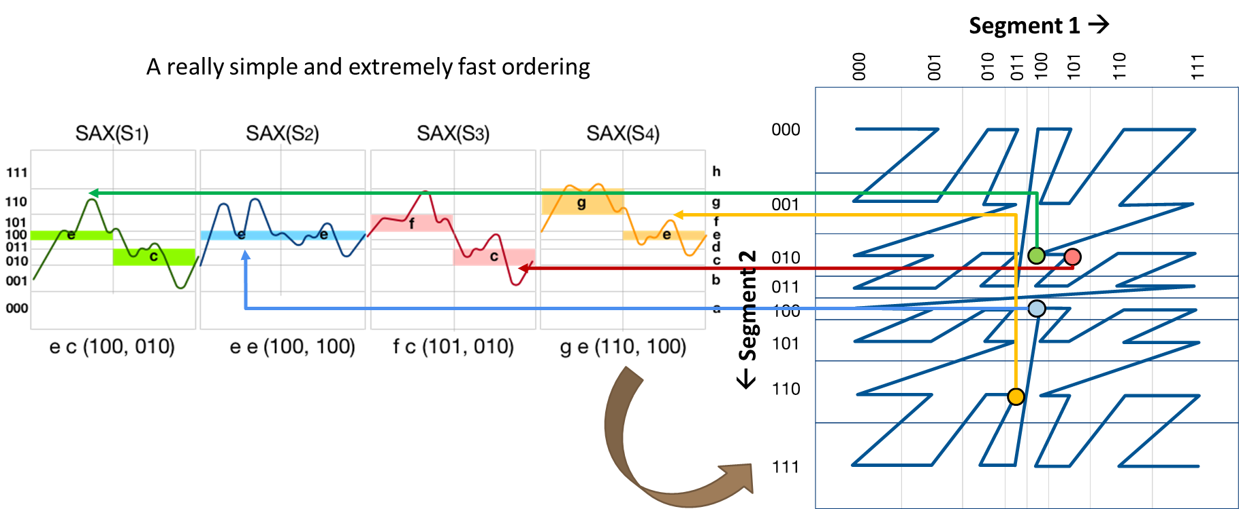
Coconut
Publications
  Kondylakis-PVLDB‘18
  Kondylakis-SIGMOD’19
current solution for limited memory devices and streaming time series
  bottom-up, succinct index construction based on sortable summarizations
Notes:
This is made possible thanks to InvSax, an isax summarization that is sortable.
Note that sorting sequences, or their summarizations is not straight-forward.
For example, two sequences may be similar in the first few points, but different in the rest.
This means that a sorted order should take into account all the points of the sequence, in order to place close to each other in the sorted order two sequences that have a small distance between them.
Coconut proposes such a solution using a space-filling curve on the embedded space of the isax summarizations of the series.

Slide 119
Coconut
Publications
  Kondylakis-PVLDB‘18
  Kondylakis-SIGMOD’19
current solution for limited memory devices and streaming time series
  bottom-up, succinct index construction based on sortable summarizations
  outperforms state-of-the-art in terms of index space, index construction time, and query answering time
Notes:
This results in an index that can be built bottom-up, bulk loaded, and densely packed.

Slide 120
Coconut
Publications
  Kondylakis-PVLDB‘18
  Kondylakis-SIGMOD’19
current solution for limited memory devices and streaming time series
  bottom-up, succinct index construction based on sortable summarizations
  outperforms state-of-the-art in terms of index space, index construction time, and query answering time
  compatible with traditional single-dimensional balanced indexes
    B+-tree, LSM-tree, …
Notes:
Moreover, we can use traditional single-dimensional indexes to do that, such as a B+-tree.

Slide 121
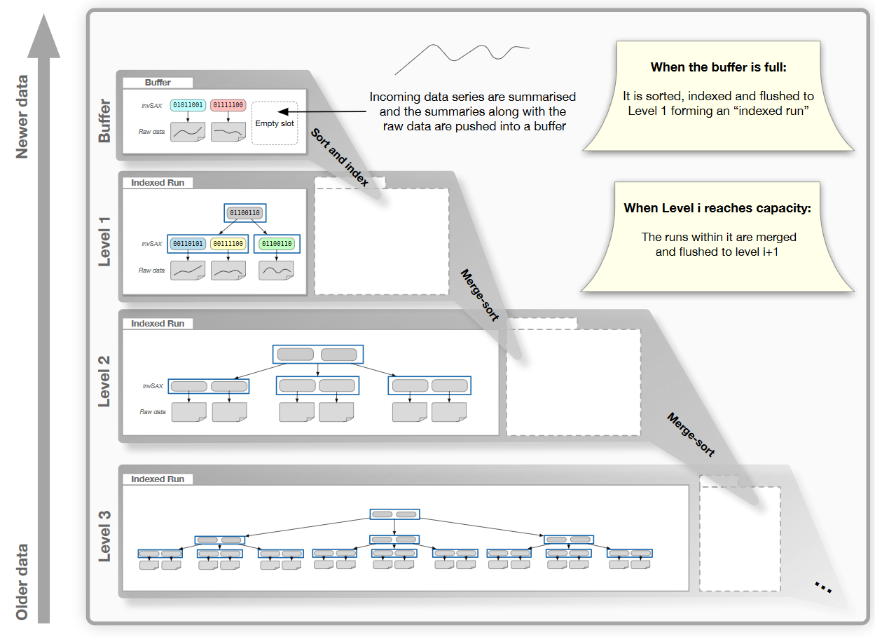
Coconut-LSM
Publications
  Kondylakis-PVLDB‘18
  Kondylakis-SIGMOD’19
  Kondylakis-VLDBJ’20
Notes:
Coconut has also been extended to operate with LSM-trees, which are adapted to online operation.
Coconut-LSM is the first data series indexing solution for similarity search in streaming time series.

Slide 122
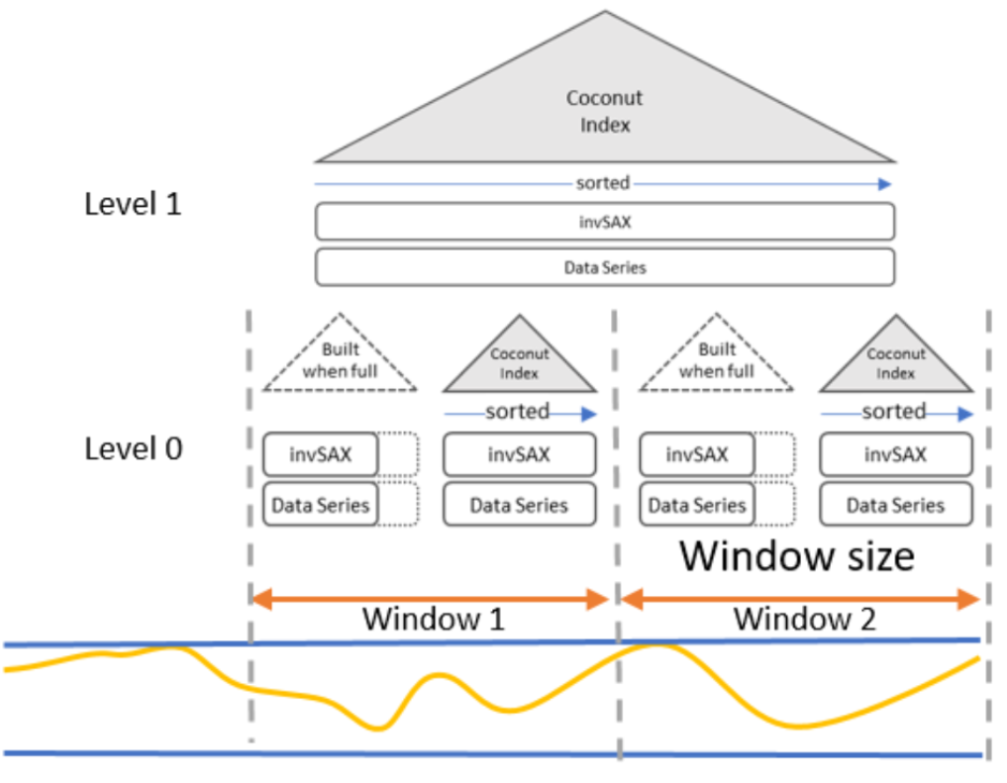
Coconut-LSM
Publications
  Kondylakis-PVLDB‘18
  Kondylakis-SIGMOD’19
  Kondylakis-VLDBJ’20
Notes:
It allows users to efficiently index and answer similarity search queries for ad-hoc windows in the past.
For example, find sequences similar to this pattern that have occurred in the stream during last week, or last August.

Slide 123
ULISSE
Publications
  Linardi-ICDE’18
  Linardi-PVLDB‘19
  Linardi-VLDBJ‘20
ULISSE: current solution for variable-length queries
  single-index support for
    queries of variable lengths
    Z-normalized + non Z-normalized data
    Euclidean + DTW distance measures
Notes:
ULISSE is a single index that can support variable-length similarity search queries, for a wide range of lengths, ranging from a few hundred to a few thousand of points.

Slide 124
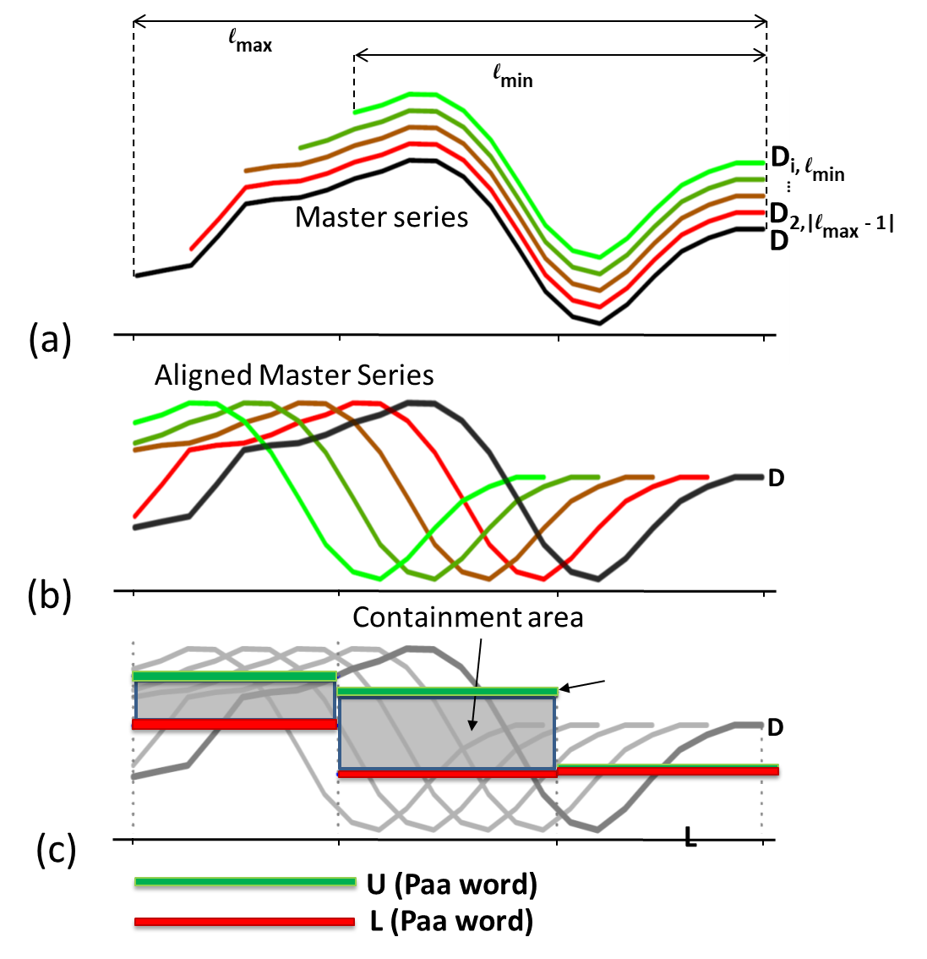
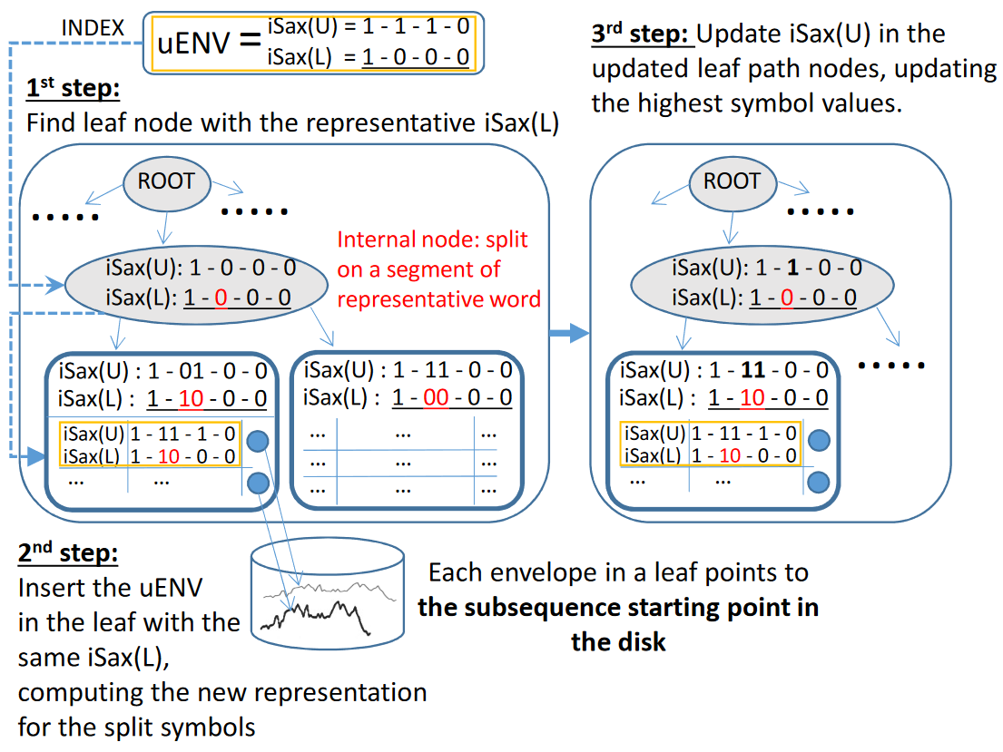
ULISSE
Publications
  Linardi-ICDE’18
  Linardi-PVLDB‘19
  Linardi-VLDBJ‘20
ULISSE: current solution for variable-length queries
  single-index support for
    queries of variable lengths
    Z-normalized + non Z-normalized data
    Euclidean + DTW distance measures
Notes:
ULISSE considers the different subsequences of a given sequence, and builds an envelope that represents them all.
Then, each node in the index stores the isax summarization of the envelope of all these subsequences.

Slide 125
ULISSE
Publications
  Linardi-ICDE’18
  Linardi-PVLDB‘19
  Linardi-VLDBJ‘20
ULISSE: current solution for variable-length queries
  single-index support for
    queries of variable lengths
    Z-normalized + non Z-normalized data
    Euclidean + DTW distance measures
  orders of magnitude faster than competing approaches
Notes:
This enables ULISSE to answer variable-length queries orders of magnitude faster than other approaches.

Slide 126
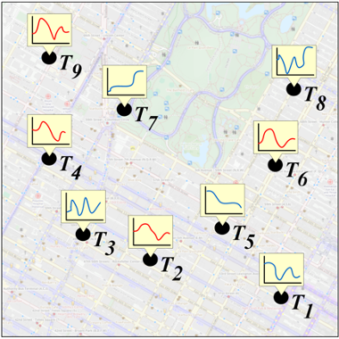
Geolocated Data Series
Publications
  Chatzigeorgakidis et al.
  SIGSPATIAL/GIS’17
search both on spatial proximity and data series similarity
Notes:
Geolocated time series are data series that are associated with specific locations. They are encountered in numerous applications, such as geosocial networks, geomarketing, geotagged user posts and sensors. In this case, we are interested in efficient similarity search when considering both spatial proximity and data series similarity,

Slide 127
Geolocated Data Series
Publications
  Chatzigeorgakidis et al.
  SIGSPATIAL/GIS’17
search both on spatial proximity and data series similarity
BTSR-Tree: hybrid index that combines Minimum Bounding Rectangles (MBR) and bundled Minimum Bounding Time Series (MBTS) to prune the search space
  prunes subtrees that cannot contain any results
Notes:
BTSR-Tree is a hybrid index that efficiently supports similarity search on geolocated data series by combining the spatial proximity and data series similarity. It is an extension of the R-Tree index, where each node is augmented with time series bounds called Minimum Bounding Time Series (or MBTS), following the same logic as the R-Tree’s MBRs.

Slide 128
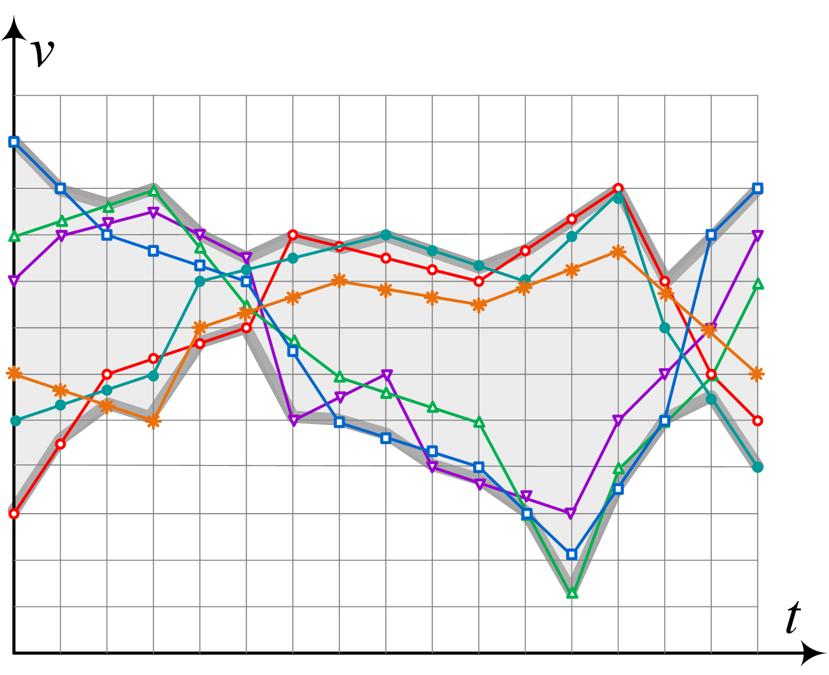
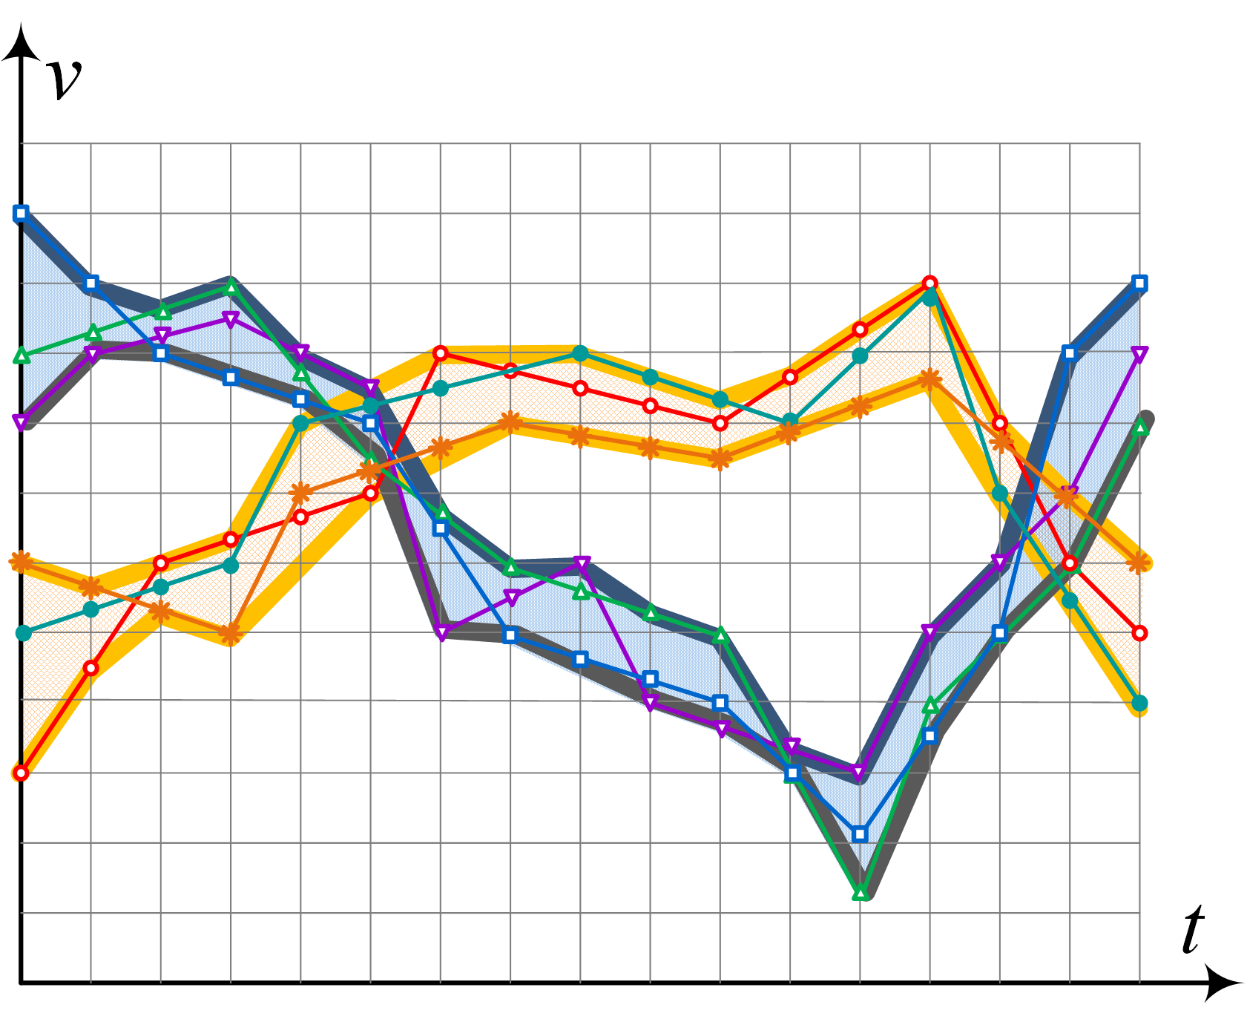
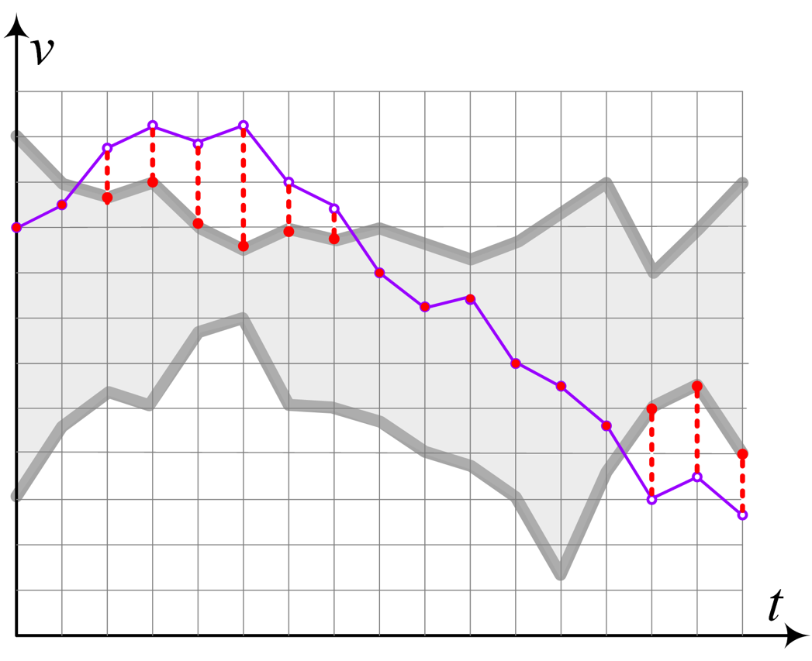
Geolocated Data Series
Publications
  Chatzigeorgakidis et al.
  SIGSPATIAL/GIS’17
search both on spatial proximity and data series similarity
BTSR-Tree: hybrid index that combines Minimum Bounding Rectangles (MBR) and bundled Minimum Bounding Time Series (MBTS) to prune the search space
  prunes subtrees that cannot contain any results
k-means
prune
Notes:
BTSR-Tree groups similar data series using k-means clustering to produce tighter bounds and eliminate dead space, thus performing more efficient pruning.
The queries are calculated by traversing the tree and pruning the subtrees that do not contain any results.
[This is done by lower bounding the instances that are contained in each node both in spatial and time series domain.]

Slide 129
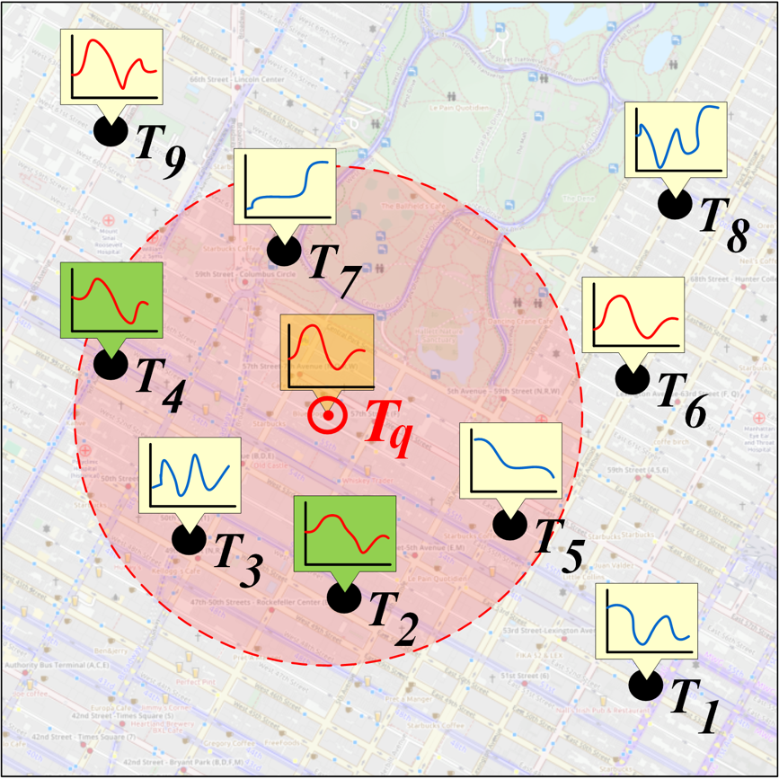
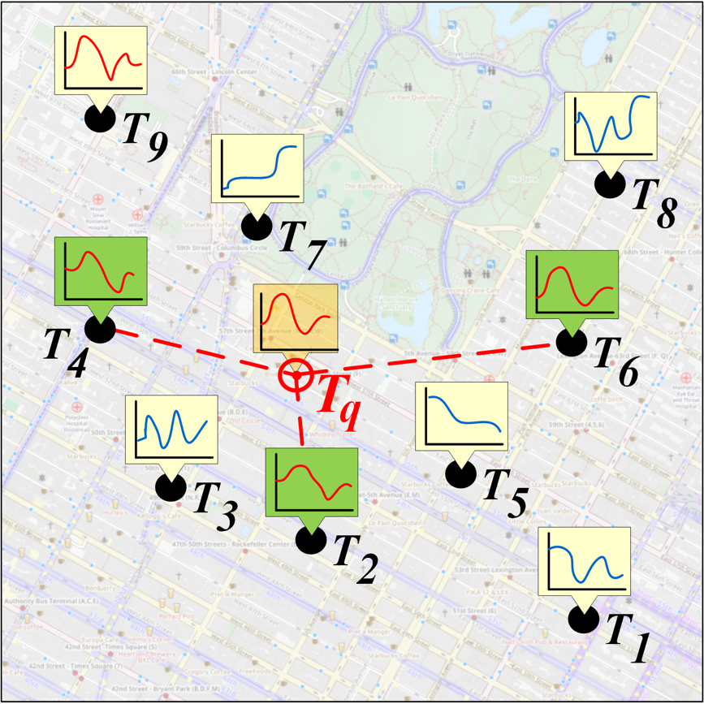
Geolocated Data Series
Publications
  Chatzigeorgakidis et al.
  SIGSPATIAL/GIS’17
search both on spatial proximity and time series similarity
BTSR-Tree: hybrid index that combines Minimum Bounding Rectangles (MBR) and bundled Minimum Bounding Time Series (MBTS) to prune the search space
  prunes subtrees that cannot contain any results
k-means
prune
Notes:
This allows for fast computation of hybrid queries, such as “Retrieve all the data series within a given spatial range that are similar to a given data series”
[by a pre-specified distance threshold”]

Slide 130
Geolocated Data Series
Publications
  Chatzigeorgakidis et al.
  SIGSPATIAL/GIS’17
  Chatzigeorgakidis et al.
  SIGSPATIAL/GIS’18
search both on spatial proximity and data series similarity
BTSR-Tree: hybrid index that combines Minimum Bounding Rectangles (MBR) and bundled Minimum Bounding Time Series (MBTS) to prune the search space
  prunes subtrees that cannot contain any results
HSJ: hybrid similarity join on geolocated data series using the BTSR-Tree
  per- and cross-partition search in parallel (adjacent bands/boxes)
Notes:
Hybrid Similarity Join (HSJ) is a technique that uses the BTSR-Tree index in order to support the computation of queries, such as “Given two geolocated data series datasets, retrieve all spatially close pairs of geolocated data series that are also similar. The authors provide a centralized implementations for HSJ, as well as a distributed one.

Slide 131
Geolocated Data Series
Publications
  Chatzigeorgakidis et al.
  SIGSPATIAL/GIS’17
  Chatzigeorgakidis et al.
  SIGSPATIAL/GIS’18
  Chatzigeorgakidis et al.
  Elsev. Big Data Res. ‘19
search both on spatial proximity and data series similarity
BTSR-Tree: hybrid index that combines Minimum Bounding Rectangles (MBR) and bundled Minimum Bounding Time Series (MBTS) to prune the search space
  prunes subtrees that cannot contain any results
HSJ: hybrid similarity join on geolocated data series using the BTSR-Tree
  per- and cross-partition search in parallel (adjacent bands/boxes)
VisExp: interactive visual exploration on geolocated data series using either geo-iSAX or BTSR-Tree
  geo-iSAX: iSAX index - nodes augmented with MBR data
Notes:
VisExp introduced two visualization methods for geolocated data series that allow for interactive visual exploration of such datasets, using the BTSR-Tree, and a geolocated variant of the iSAX index, …

Slide 132
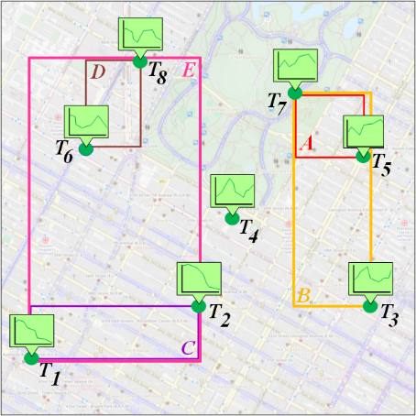
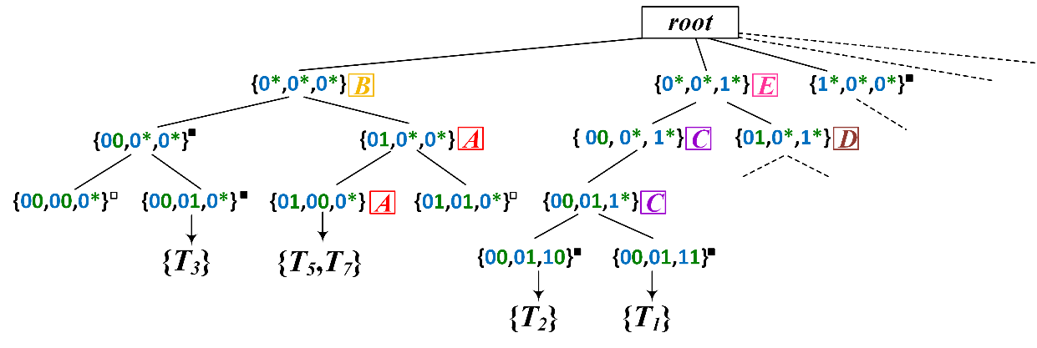
Geolocated Data Series
Publications
  Chatzigeorgakidis et al.
  SIGSPATIAL/GIS’17
  Chatzigeorgakidis et al.
  SIGSPATIAL/GIS’18
  Chatzigeorgakidis et al.
  Elsev. Big Data Res. ‘19
search both on spatial proximity and data series similarity
BTSR-Tree: hybrid index that combines Minimum Bounding Rectangles (MBR) and bundled Minimum Bounding Time Series (MBTS) to prune the search space
  prunes subtrees that cannot contain any results
HSJ: hybrid similarity join on geolocated data series using the BTSR-Tree
  per- and cross-partition search in parallel (adjacent bands/boxes)
VisExp: interactive visual exploration on geolocated data series using either geo-iSAX or BTSR-Tree
  geo-iSAX: iSAX index - nodes augmented with MBR data
Notes:
…which adds to each node an MBR of its children’s locations.

Slide 133
Geolocated Data Series
Publications
  Chatzigeorgakidis et al.
  SIGSPATIAL/GIS’17
  Chatzigeorgakidis et al.
  SIGSPATIAL/GIS’18
  Chatzigeorgakidis et al.
  Elsev. Big Data Res. ‘19
search both on spatial proximity and data series similarity
BTSR-Tree: hybrid index that combines Minimum Bounding Rectangles (MBR) and bundled Minimum Bounding Time Series (MBTS) to prune the search space
  prunes subtrees that cannot contain any results
HSJ: hybrid similarity join on geolocated data series using the BTSR-Tree
  per- and cross-partition search in parallel (adjacent bands/boxes)
VisExp: interactive visual exploration on geolocated data series using either geo-iSAX or BTSR-Tree
  geo-iSAX: iSAX index - nodes augmented with MBR data
Notes:
This is an example of the BTSR-Tree-based visualization. When the user zooms the map in the red rectangle, the system identifies and presents the data series patterns that are contained in it. To avoid cluttering the map, it only displays the number of data series per identified pattern and their respective centroids. Individual data series are depicted only at a greater zoom level.

Slide 134
Geolocated Data Series
Publications
  Chatzigeorgakidis et al.
  SIGSPATIAL/GIS’17
  Chatzigeorgakidis et al.
  SIGSPATIAL/GIS’18
  Chatzigeorgakidis et al.
  Elsev. Big Data Res. ‘19
search both on spatial proximity and data series similarity
BTSR-Tree: hybrid index that combines Minimum Bounding Rectangles (MBR) and bundled Minimum Bounding Time Series (MBTS) to prune the search space
  prunes subtrees that cannot contain any results
HSJ: hybrid similarity join on geolocated data series using the BTSR-Tree
  per- and cross-partition search in parallel (adjacent bands/boxes)
VisExp: interactive visual exploration on geolocated data series using either geo-iSAX or BTSR-Tree
  geo-iSAX: iSAX index - nodes augmented with MBR data
Notes:
This is an example of the geo-iSAX-based visualization. The user draws a rectangle on the data series visualization panel at the bottom of the image, and the system issues a timebox query.
Then, it retrieves the MBRs that contain values within the drawn rectangle, it groups them and outputs the corresponding MBRs on the map.

Slide 135
spaTScope
Publications
  Chatzigeorgakidis et al.
  SIGSPATIAL/GIS’20
interactive demo application for visual geolocated data series exploration
  zoom-in/out, pan the map and receive summaries of geolocated data series and corresponding MBRs
Notes:
spaTScope is an interactive demo application of the BTSR-Tree-based geolocated data series visual exploration method.

Slide 136
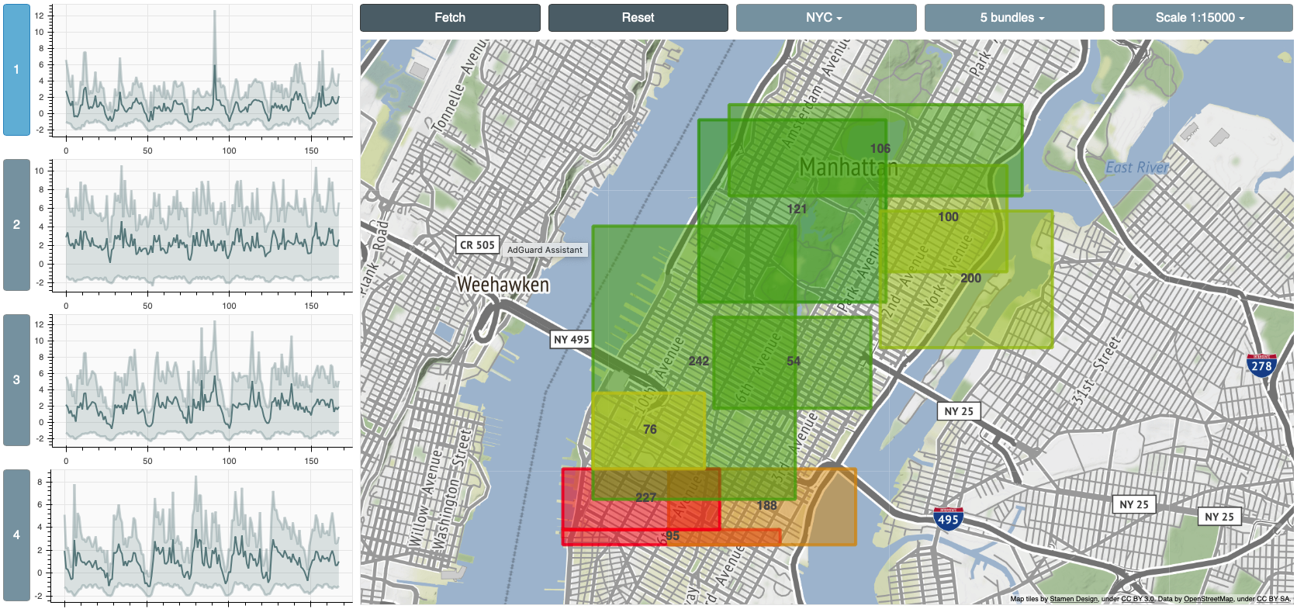
spaTScope
Publications
  Chatzigeorgakidis et al.
  SIGSPATIAL/GIS’20
interactive demo application for visual geolocated data series exploration
  zoom-in/out, pan the map and receive summaries of geolocated data series and corresponding MBRs
Notes:
The user can interactively zoom-in/out, pan the map and receive summaries of geolocated data series and corresponding MBRs.

Slide 137
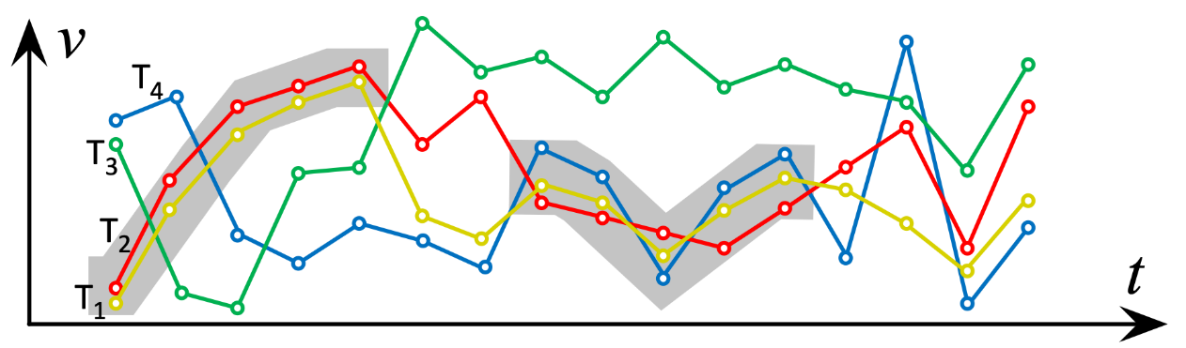
Twin Subsequence Search
Publications
  Chatzigeorgakidis et al.
  SSTD’19
discover subsequences, where distance between points is always < ε
Notes:
Twin subsequences is another interesting type of similarity queries, where we want to find subsequences, for which the largest value difference across all timestamps is less than a given threshold epsilon.
This is called the Chebyshev distance between the two subsequences.

Slide 138
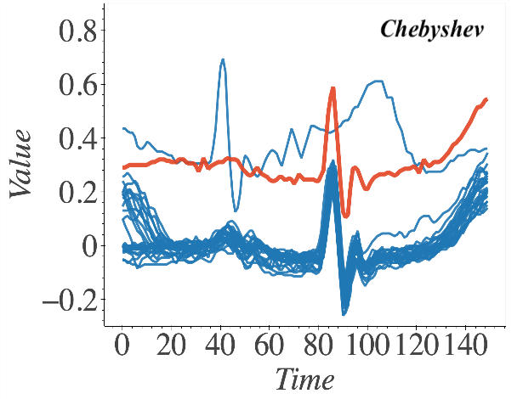
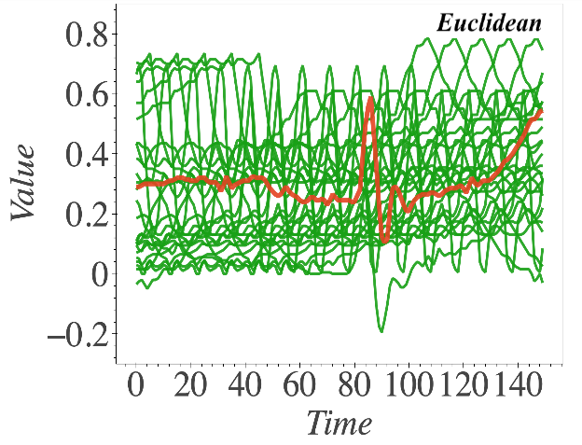
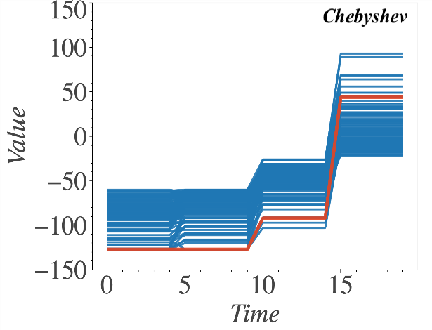
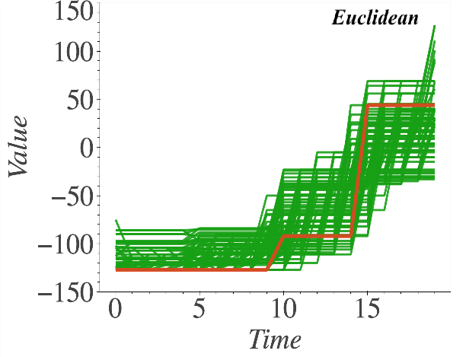
Twin Subsequence Search
Publications
  Chatzigeorgakidis et al.
  SSTD’19
discover subsequences, where distance between points is always < ε
results that are
Chebyshev-similar
to the red queries
results that are
Euclidean-similar
to the red queries
Notes:
Chebyshev represents a very useful distance in practice.
This figure shows example results for the two red queries, in Electrocardiography (ECG) data on top and Electrooculography (EOG) data at the bottom, when using Chebyshev distance on the left, and Euclidean on the right.
We can see that the Chebyshev distance can help maintain some useful similarity properties.

Slide 139
Twin Subsequence Search
Publications
  Chatzigeorgakidis et al.
  SSTD’19
discover subsequences, where distance between points is always < ε
SL/CP: solutions for pairs/groups of (x-axis) aligned subsequences of length ≥δ, within large collections of (short) data series
  prunes search space by discretizing values, and using checkpoints
Notes:
The SL/CP algorithms were designed to discover all possible pairs and groups of aligned twin subsequences of length at least delta.

Slide 140
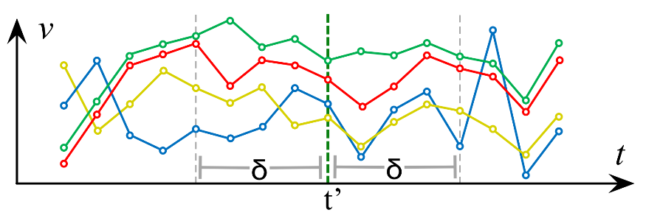
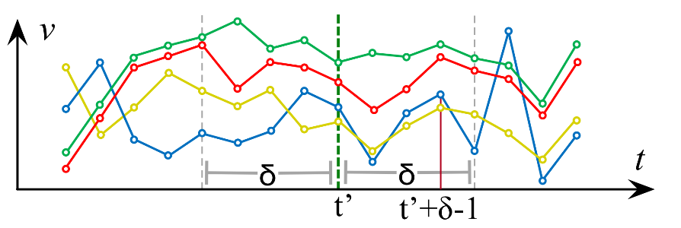

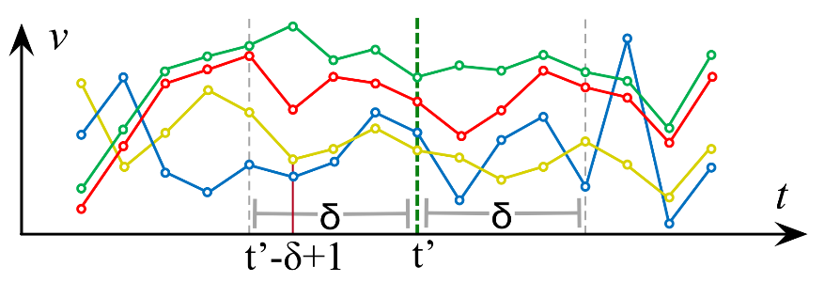
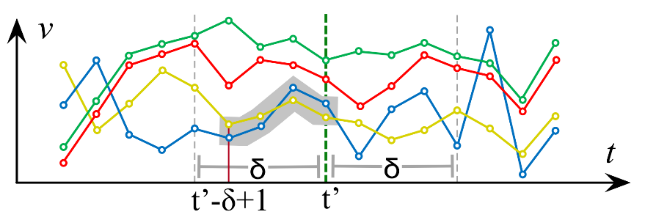
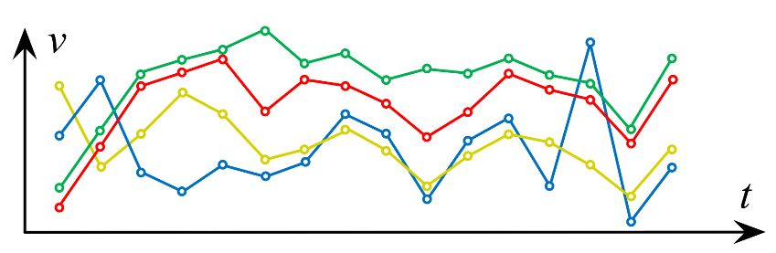

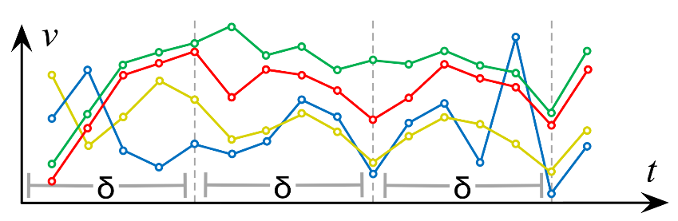
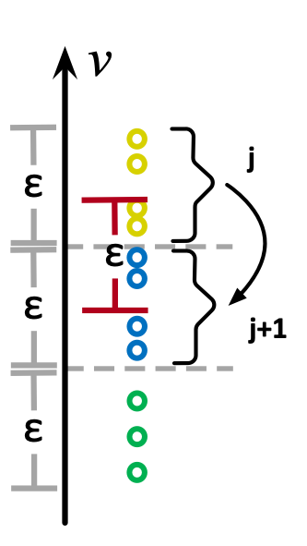
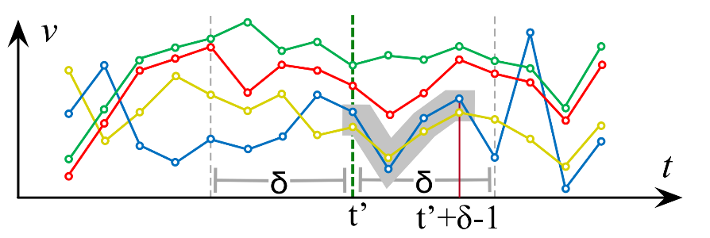
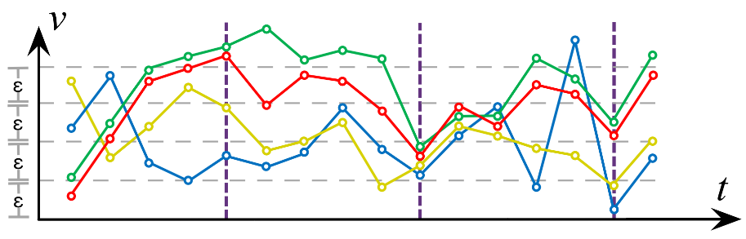
Twin Subsequence Search
Publications
  Chatzigeorgakidis et al.
  SSTD’19
discover subsequences, where distance between points is always < ε
SL/CP: solutions for pairs/groups of (x-axis) aligned subsequences of length ≥δ, within large collections of (short) data series
  prunes search space by discretizing values, and using checkpoints
Notes:
Since discovering such pairs and groups requires rather exhaustive computations, these algorithms prune the search space by discretizing values, and using checkpoints that essentially partition the problem.

Slide 141
Twin Subsequence Search
Publications
  Chatzigeorgakidis et al.
  SSTD’19
  Chatzigeorgakidis et al.
  SIGSPATIAL/GIS’19
discover subsequences, where distance between points is always < ε
SL/CP: solutions for pairs/groups of (x-axis) aligned subsequences of length ≥δ, within large collections of (short) data series
  prunes search space by discretizing values, and using checkpoints
SBTSR-Tree: solution for (x-axis) aligned subsequences within large collections of (short) data series, which are geolocated
  BTSR-Tree index on segmented data series, with bit-vectors that mark continuity of same series across segments
Notes:
The SBTR-Tree extends the twin subsequence search problem on geolocated data series. It is an extension of the BTSR-Tree that is built on segmented data series.

Slide 142
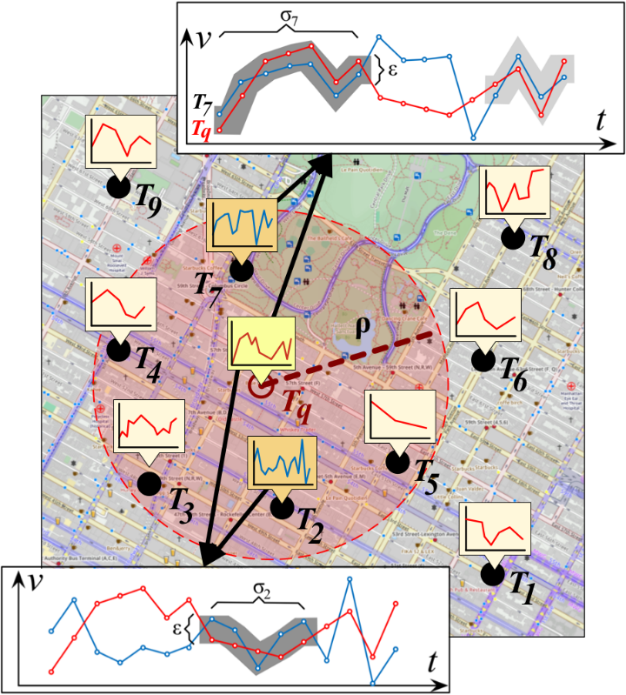
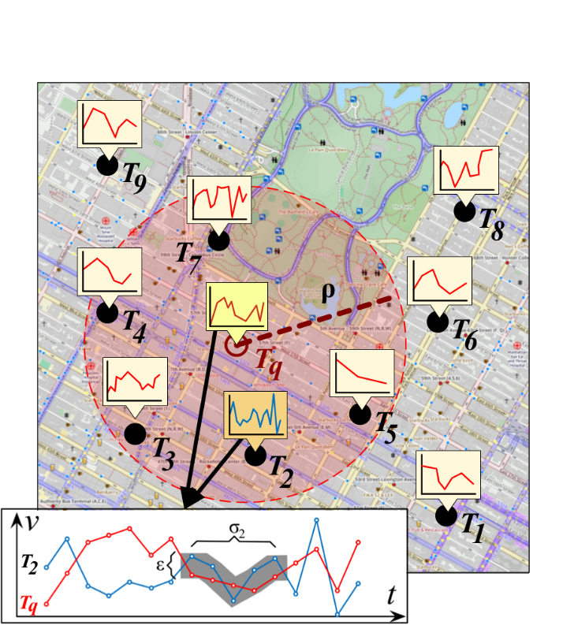
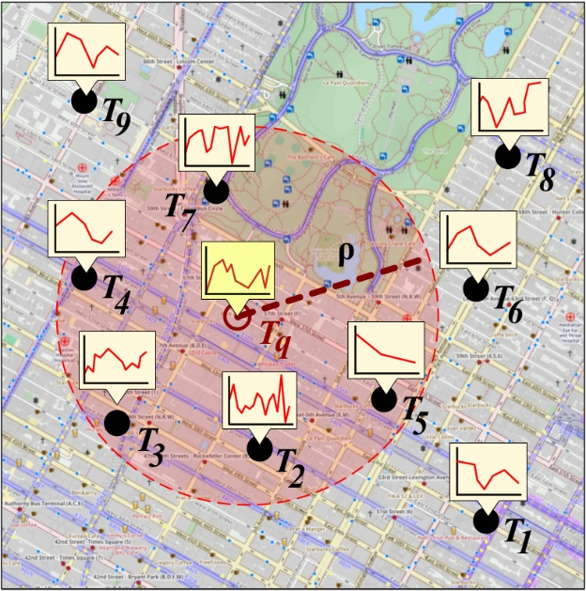
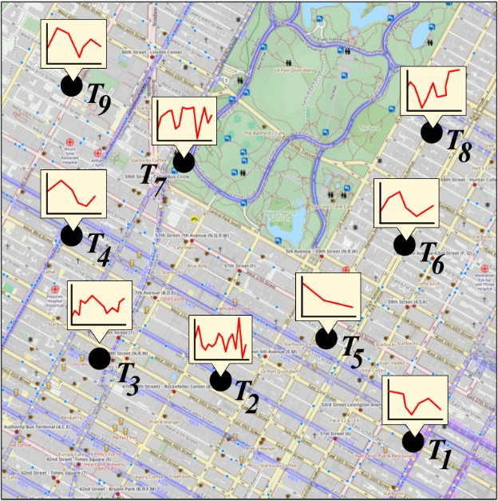
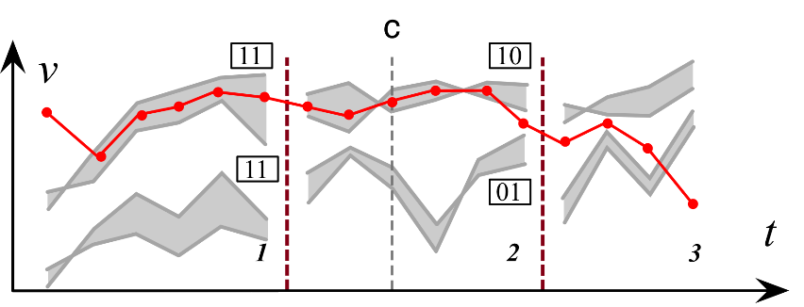


Twin Subsequence Search
Publications
  Chatzigeorgakidis et al.
  SSTD’19
  Chatzigeorgakidis et al.
  SIGSPATIAL/GIS’19
discover subsequences, where distance between points is always < ε
SL/CP: solutions for pairs/groups of (x-axis) aligned subsequences of length ≥δ, within large collections of (short) data series
  prunes search space by discretizing values, and using checkpoints
SBTSR-Tree: solution for (x-axis) aligned subsequences within large collections of (short) data series, which are geo-located
  BTSR-Tree index on segmented data series, with bit-vectors that mark continuity of same series across segments
Notes:
The SBTSR-Tree allows the computation of hybrid queries such as: “Given an input series, a value threshold epsilon and a minimum subsequence duration delta, retrieve all series within the given radius that are locally similar to the query”.
The example in this figure shows that for the query Tq in the center, we retrieve the answers that are spatially within the red circle, and that in addition have a subsequence of length delta that is similar to the corresponding subsequence of the query series Tq.
[It employs bit-vectors to mark the continuity of the same series across segments.]

Slide 143
Twin Subsequence Search
Publications
  Chatzigeorgakidis et al.
  EDBT’21
discover subsequences, where distance between points is always < ε
TS-Index: solution for subsequences of a long data series T that are similar to a (short) query sequence of length l
  k-ary balanced index, built on per-point min/max envelopes of all l-length subsequences of T
Notes:
TS-Index is a tree-based index that is optimized for twin subsequence queries.
It uses bounds to prune the search space.
Given a long series and a query subsequence, the TS-Index finds the subsequences for which the Chebyshev distance is less than a given threshold epsilon.

Slide 144



Twin Subsequence Search
Publications
  Chatzigeorgakidis et al.
  EDBT’21
discover subsequences, where distance between points is always < ε
TS-Index: solution for subsequences of a long data series T that are similar to a (short) query sequence of length l
  k-ary balanced index, built on per-point min/max envelopes of all l-length subsequences of T
Notes:
TS-Index is k-ary balanced index, built on the [per-point] minimum and maximum envelopes (MBTS) of all possible subsequences of the input time series.

Slide 145
Twin Subsequence Search
Publications
  Chatzigeorgakidis et al.
  EDBT’21
  Chatzigeorgakidis et al.
  TKDE‘22
discover subsequences, where distance between points is always < ε
TS-Index: solution for subsequences of a long data series T that are similar to a (short) query sequence of length l
  k-ary balanced index, built on per-point min/max envelopes of all l-length subsequences of T
TS-Index OPT: memory footprint and bulk-loading optimizations for TS-Index
  build index bottom-up after sorting and grouping the subsequences using a z-order space filling curve
Notes:
The TS-Index algorithm was later optimized to reduce the memory footprint by using the Piecewise Aggregate Approximation summarization for the envelopes of each node of the index node, and to reduce index building times by enabling bulk-loading in a way similar to Coconut: the index is built bottom-up after sorting and grouping the subsequences using a z-order space filling curve.

Slide 146
Data Series Indexing
Parallel & Distributed

Slide 147
ADS Index creation
~60% of time spent in CPU: potential for improvement!
Notes:
We can see that 60% of time is CPU time. We concentrate on how to reduce that.

Slide 148
ParIS+
Parallel Indexing of Sequences
Publications
  Peng-BigData’18
  Peng-
  TKDE’20
solution for SIMD, multi-core, multi-socket architectures
  completely masks out the CPU cost during index creation
  answers exact queries in the order of few secs on 100GB dataset
    up to 3 orders of magnitude faster then single-core solutions
Notes:
ParIS results in query answering up to 3 orders of magnitude faster than single core solutions, which has interesting implications for complex analytics tasks, as well.

Slide 149

ParIS+
Parallel Indexing of Sequences
Publications
  Peng-BigData’18
  Peng-
  TKDE’20
solution for SIMD, multi-core, multi-socket architectures
  completely masks out the CPU cost during index creation
  answers exact queries in the order of few secs on 100GB dataset
    up to 3 orders of magnitude faster then single-core solutions
k-NN Classification
18x faster
Notes:
When using the same hardware and data, ParIS is 18x faster than ADS+ on this task.

Slide 150
ParIS+
Parallel Indexing of Sequences
Publications
  Peng-BigData’18
  Peng-
  TKDE’20
solution for SIMD, multi-core, multi-socket architectures
  completely masks out the CPU cost during index creation
  answers exact queries in the order of few secs on 100GB dataset
    up to 3 orders of magnitude faster then single-core solutions
k-NN Classification
classifying 100K objects using a 100GB dataset goes down from several days to few hours!
18x faster
Notes:
This means that classification time for 100K objects goes from several days down to a few hours, all while using the same hardware.

Slide 151
Index creation
create
thread
SAX
Raw Data Buffer
IdxBulkLoading worker
Double Buffer
B₁
Array of iSAX Summarizations
B₂
RecBuf
ROOT
RecBuf
Coordinate
Worker
0 0 0
. . .
1 1 1
Main memory
RAW Data
Disk
Notes:
The coordinate worker switch the pointer of the double buffer to do the next round.

Slide 152
create thread
Index creation
Coordinate
Worker
IdxConstr worker 1
…
IdxConstr worker k
RecBuf
ROOT
RecBuf
0 0 0
. . .
1 1 1
0 00 0
0 01 0
1 1 10
1 1 11
1 10 11
1 11 11
OutBuf
OutBuf
OutBuf
OutBuf
Main memory
Disk
RAW Data
Notes:
Builds the corresponding index subtree. So, root subtrees are built in parallel. The leaves of each subtree is flushed to the disk at the end of the tree construction process

Slide 153
ParIS+ exact query answering
1. Query q arrives
create thread
5. Calculate LB distance
& generate candidate list
ROOT
SAX
C _{l}
LB_dist
LB_dist
. . .
. . .
LBC Worker
LB_dist
0 0 0
0 00 0
0 01 0
2. Run
approximate
search
LB_dist
LB_dist
Array of iSAX
Summarizations
Array of
Candidate List
0 01 00
0 01 01
Main memory
Disk
3. Read raw data
for series in leaf
RAW File
4.Get BSF
Notes:
Then, the main thread create several lower bound distance calculation worker to calculate the lower bound distance and add the lower bound distance position pair into the candidate list when the lower bound distance is lower than BSF

Slide 154
Lower-Bound Distance Calculation in SIMD
query ABOVE candidate
query BELOW candidate
query IN candidate
query series:
PAA representation
1. Query q arrives
create thread
5. Calculate LB distance
& generate candidate list
…
ROOT
SAX
C _{l}
candidate series:
iSAX representation
LB_dist
LB_dist
. . .
. . .
LBC Worker
LB_dist
0 0 0
Result above branch
Dist_above[1] | Dist_above[2] | Dist_above[3] | Dist_above[4]
…
0 00 0
0 01 0
2. Run
approximate
search
LB_dist
Mask above branch
LB_dist
…
TRUE |  | TRUE
Array of iSAX
Summarizations
Array of
Candidate List
0 01 00
0 01 01
Result below branch
Dist_below[1] | Dist_below[2] | Dist_below[3] | Dist_below[4]
…
Main memory
Mask below branch
 |  |  | TRUE
…
Disk
3. Read raw data
for series in leaf
RAW File
Result in branch
Dist_in[1] | Dist_in[2] | Dist_in[3] | Dist_in[4]
…
Mask in branch
 | TRUE
…
4.Get BSF
…
Final Result
Dist_above[1] | Dist_in[2] | Dist_above[3] | Dist_below[4]
SIMD register (8 points)
Notes:
Get the final result

Slide 155
Lower-Bound Distance Calculation in SIMD
1. Query q arrives
create thread
5. Calculate LB distance
& generate candidate list
ROOT
SAX
C _{l}
LB_dist
LB_dist
. . .
. . .
LBC Worker
LB_dist
0 0 0
0 00 0
0 01 0
2. Run
approximate
search
LB_dist
LB_dist
Array of iSAX
Summarizations
Array of
Candidate List
0 01 00
0 01 01
Main memory
Disk
3. Read raw data
for series in leaf
RAW File
4.Get BSF
SIMD lower bounds are 3.4x faster
Notes:
SIMD lower bound distance calculation is 3.4x faster than SISD version.

Slide 156
ParIS+ exact query answering
create thread
5. Calculate LB distance
& generate candidate list
create thread
1. Query q arrives
6. Read raw data
using candidate
list order
ROOT
SAX
C _{l}
LB_dist
LB_dist
. . .
. . .
LBC Worker
LB_dist
RDC Worker
0 0 0
0 00 0
0 01 0
2. Run
approximate
search
LB_dist
LB_dist
Array of iSAX
Summarizations
Array of
Candidate List
0 01 00
0 01 01
7. Update BSF
BSF
Main memory
Disk
3. Read raw data
for series in leaf
RAW File
4.Get BSF
…
Notes:
Then, the worker reads the required data from disk, calculates the real distance and if necessary, updates the shared BSF variable.

Slide 157
MESSI
In-Memory Data Series Index
Publications
  Peng-
  ICDE’20
  Peng-
  VLDBJ’21
in-memory solution for SIMD, multi-core, multi-socket architectures
  index-creation algorithm
    balances workload of different workers, minimizes synchronization cost
  exact query answering algorithm
    optimizes tree traversal and pruning
    minimizes number of lower-bound and real distance calculations
  answers exact queries at interactive speeds: ~50msec on 100GB
    up to 11x faster than competing approaches
Notes:
MESSI is an extension of ParIS for memory-resident data.
This index takes advantage of the fact that random accesses in main memory are fast, so it uses tree traversals more aggressively than ParIS for its query answering algorithm.

Slide 158

MESSI Query answering – Stage 3
Notes:
Let’s now see how MESSI answers queries.

Slide 159
MESSI Query answering – Stage 3
1. Query q arrives
ROOT
0 0 0
. . .
. . .
0 00 0
0 01 0
2. Run
approximate
search
0 01 00
0 01 01
Raw Data
3. Read raw data
for series in leaf
…
4.Get BSF
Notes:
And get the BSF value

Slide 160

MESSI Query answering – Stage 3
ROOT
…
…
1. Query q arrives
Search worker
ROOT
Internal node
0 0 0
. . .
. . .
5. Traverse
tree index
Internal node
0 00 0
0 01 0
2. Run
approximate
search
Leaf node
Leaf node
Leaf node
0 01 00
0 01 01
6. Calculate
node distance
7. if node dist<BSF
insert node in PQ
Raw Data
3. Read raw data
for series in leaf
PQ[0]
PQ[0]
PQ[0]
Priority Queues
…
4.Get BSF
shared data structures
Notes:
The leaves of the subtrees that cannot be pruned are placed into a fixed number of minimum priority queues, using the lower bound distance between the raw values of the query series and
the iSAX summary of the leaf node, in order to be further examined. Each thread inserts elements in the priority queues in a round-robin fashion so that load balancing is achieved. This results in all queues containing about the same number of elements.

Slide 161

MESSI Query answering – Stage 3
PQ[0]
PQ[0]
PQ[0]
Priority Queues
8. Pop node from
a priority queue
9. Calculate lower
bound distances
ExactSearch worker
Leaf node
10. Calculate real
distances for
non-pruned
series
& update BSF
LB_dist
Real_dist
LB_dist
Real_dist
LB_dist
LB_dist
Raw Data
BSF
…
shared
variable
11. Produce final
1-NN answer
Notes:
At the end of the calculation, the value of Best-So-Far is returned as the nearest neighbor answer.

Slide 162
SING
Sequence Indexing Using GPUs
Publications
  Peng-
  ICDE’21
in-memory solution for SIMD, multi-core, multi-socket architectures with GPUs (Graphical Processing Units)
  new exact query answering algorithm
    CPU-GPU co-processing framework
    new GPU-friendly lower bound distance calculation algorithm
  answers exact queries at interactive speeds: ~32msec on 100GB dataset
    up to 5x faster than competing approaches
Notes:
Finally, SING is an extension of MESSI that also takes advantage of GPU processors for similarity search query answering of memory-resident data.
SING achieves interactive query answering times for exact similarity search over 100GB sequence collections, taking a mere 32msec per query.

Slide 163
GPUs for Data Series Similarity Search
a natural solution
  GPUs typically part of modern hardware
  GPUs offer massive parallelization opportunities
  data series operations are massively parallelizable
Notes:
so the question is: can we use GPUs to accelerate data series similarity search?

Slide 164
GPUs for Data Series Similarity Search
a natural solution
  GPUs typically part of modern hardware
  GPUs offer massive parallelization opportunities
  data series operations are massively parallelizable
challenges
  Limited GPU memory size (~12GB of RAM for modern GPUs)
    much smaller than raw data
  Slow interconnect speeds (PCI-Express 3.0 x16 delivers 10GB/sec)
    moving raw data needed by individual queries prohibitively expensive
  non-sophisticated Streaming Processors (GPU cores)
    not suited for supporting complex data structures/branching
    very limited in-core fast memory
  trade-offs will change as GPU and interconnects technology advances
Notes:
so the question is: can we use GPUs to accelerate data series similarity search?

Slide 165
SING Query answering
query
CPU
Search
perform approximate search, compute BSF
compute LBDs for children of root,
compute contiguous interval with all non-pruned nodes
GPU
calculate LBDs only for series under a node inside the
intervals with all non-pruned nodes
traverse index, insert leaf nodes in priority queue(s)
sorted iSAX array
FMapG
-
-
LB_dist
LB_dist
LB_dist
LB_dist
-
-
LB_dist
LB_dist
-
-
-
Notes:
And store the distance in an array

Slide 166

ax3+bx
SING Query answering
query
CPU
Search
GPU-friendly Lower Bound Distance Computations
perform approximate search, compute BSF
compute LBDs for children of root,
compute contiguous interval with all non-pruned nodes
GPU
traverse index, insert leaf nodes in priority queue(s)
LB_dist
LB_dist
-
Breakpoint=breakpoint[Sax]
-
-
Notes:
Priviously we calculate the breakpoint from the segment by searching table.

Slide 167
ax3+bx
SING Query answering
query
CPU
Search
GPU-friendly Lower Bound Distance Computations
perform approximate search, compute BSF
GPU
-
Breakpoint=breakpoint[Sax]
BreakPoly(Sax)=a*(Sax)³+b*(Sax)
-
-
Notes:
SING follows a different approach for performing each lower bound distance
calculation. the GPU directly calculates the break point values of
the iSAX symbols using a function. It will eascapre from the huge sigiser overheald keep the parser locally.

Slide 168
255 32-bit registers
SING Query answering
query
Search
Time of Lower Bound Distance Computations
perform approximate search, compute BSF
compute LBDs for children of root,
compute contiguous interval with all non-pruned nodes
GPU
LB_dist
LB_dist
-
-
-
GPU with BreakPoly() breakpoints is ~10x faster
Notes:
The Breakpoly approach is 9.8x faster than dictionary approach.

Slide 169
SING Query answering
query
CPU
Search
perform approximate search, compute BSF
compute LBDs for children of root,
compute contiguous interval with all non-pruned nodes
GPU
calculate LBDs only for series under a node inside the
intervals with all non-pruned nodes
traverse index, insert leaf nodes in priority queue(s)
Priority
Queues
tree index
sorted iSAX array
FMapG
FMapC
-
-
-
-
Search
raw data array
LB_dist
LB_dist
check priority queue(s), process leaf nodes.
LB_dist
LB_dist
LB_dist
LB_dist
LB_dist
LB_dist
check LBD values in FmapC or calculate it,
calculate real distances
-
-
check LBD values in FmapC or calculate it,
calculate real distances
-
-
LB_dist
LB_dist
LB_dist
LB_dist
-
-
update BSF, use new BSF to prune better
-
-
-
-
1-NN answer
Notes:
And update BSF if necessary, finally, ouput the answer.

Slide 170
DPiSAX
Distributed Partitioned iSAX
Publications
  Yagoubi-ICDM‘17
  Yagoubi-TKDE’18
  Lavchenko-KAIS’20
solution for distributed processing (Spark)
  balances work of different worker nodes
    partitions series into uniform groups with parallel sampling (for load balancing)
    creates in parallel an index for each group (in a different node)
Notes:
In terms of distribution and parallelization, DPiSAX is an extension of isax2+ that operates on the Spark distributed platform.

Slide 171


DPiSAX
Distributed Partitioned iSAX
Publications
  Yagoubi-ICDM‘17
  Yagoubi-TKDE’18
  Lavchenko-KAIS’20
solution for distributed processing (Spark)
  balances work of different worker nodes
    partitions series into uniform groups with parallel sampling (for load balancing)
    creates in parallel an index for each group (in a different node)
Notes:
DpiSAX uses the isax summarization to effectively balance the workload of each node in the Spark cluster, before actually building the index.
Partitioning.
The first stage is done as follows. Given a desired number of partitions P and a time series dataset D, the algorithm takes a sample S of size L time series from D using stratified sampling, and emits its iSAX words SWs={iSAX(tsi),i= 1,...,L}, initially assigned to a single partition. At each iteration, DPiSAX divides the sample by splitting the biggest partition into two sub-partitions, until the number of partitions reaches P, using the same splitting policy, as defined for iSAX tree index construction. As a result, the binary tree is converted to a partition table, where each leaf-node represents a partition, described with its iSAX word, and will become a root node of each sub-tree of the distributed index.–Parallel sub-index creation. On the next stage, the input dataset D, is mapped to iSAX representation DWs={iSAX(tsi),i= 1,...,N}with the highest possible cardinalities of each symbol. Then, the database partitions are dis-tributed among the available workers. Each worker builds locally its iSAX index sub-tree on the given partition of time series and stores it on HDFS in JSON format. Alongside, each leaf node (terminal node) is stored to HDFS as a file with corresponding time series ids and their iSAX representations.

Slide 172
DPiSAX
Distributed Partitioned iSAX
Publications
  Yagoubi-ICDM‘17
  Yagoubi-TKDE’18
  Lavchenko-KAIS’20
solution for distributed processing (Spark)
  balances work of different worker nodes
    partitions series into uniform groups with parallel sampling (for load balancing)
    creates in parallel an index for each group (in a different node)
  speeds-up query answering
    exact queries are answered by all nodes (parallelize query execution)
    approximate queries answered only by a single node (parallelize workload execution)
Notes:
This results in batch query answering 2 orders of magnitude faster than centralized approaches.

Slide 173
iSAX Index Family Lineage Tree
Publications
  Palpanas-ISIP‘19
timeline
2008
2010
2014
2015
2017
2018
2019
2020
basic
index
iSAX
C#
+ Bulk
Loading
iSAX 2.0
iSAX2+
iSAX2+*
C#, C
+ Adaptive
ADS / ADS+
ADSFull
ADS+*
C
+ Distributed
DPiSAX
Java
(Spark)
+ Multi-Core,
Multi-Socket, SIMD
ParIS
ParIS+
MESSI
C
+ Graphics Processing
Units (GPUs)
SING
C
+ Sortable Summarizations,
Streaming Data Series
Coconut-Trie / Coconut-Tree
Coconut-LSM
C
+ Variable-Length Queries
ULISSE
C
Timeline depicted on top; implementation languages marked on the right. Solid arrows denote inheritance of index design; dashed arrows denote inheritance of some of the design features; two new versions of iSAX2+/ADS+ marked with asterisk support approximate similarity search with deterministic and probabilistic quality guarantees.
Notes:
Solid line inherits design
Dashed line inherits some of the design feaures
Star denotes extension that supports approximate answers with quality guarantees

Slide 174
iSAX Index Family Lineage Tree
Publications
  Palpanas-ISIP‘19
timeline
2008
2010
2014
2015
2017
2018
2019
2020
basic
index
600 sec
C#
iSAX
+ Bulk
Loading
iSAX 2.0
iSAX2+
iSAX2+*
C#, C
+ Adaptive
ADS / ADS+
ADSFull
ADS+*
C
+ Distributed
DPiSAX
Java
(Spark)
+ Multi-Core,
Multi-Socket, SIMD
ParIS
ParIS+
MESSI
C
+ Graphics Processing
Units (GPUs)
SING
C
+ Sortable Summarizations,
Streaming Data Series
Coconut-Trie / Coconut-Tree
Coconut-LSM
C
+ Variable-Length Queries
ULISSE
C
execution time for 1 similarity search query on a 100GB dataset on disk
Timeline depicted on top; implementation languages marked on the right. Solid arrows denote inheritance of index design; dashed arrows denote inheritance of some of the design features; two new versions of iSAX2+/ADS+ marked with asterisk support approximate similarity search with deterministic and probabilistic quality guarantees.
Notes:
Solid line inherits design
Dashed line inherits some of the design feaures
Star denotes extension that supports approximate answers with quality guarantees

Slide 175
iSAX Index Family Lineage Tree
Publications
  Palpanas-ISIP‘19
timeline
2008
2010
2014
2015
2017
2018
2019
2020
basic
index
600 sec
C#
iSAX
+ Bulk
Loading
iSAX 2.0
iSAX2+
iSAX2+*
C#, C
+ Adaptive
5o sec
ADS / ADS+
ADSFull
ADS+*
C
+ Distributed
DPiSAX
Java
(Spark)
+ Multi-Core,
Multi-Socket, SIMD
ParIS
ParIS+
MESSI
C
+ Graphics Processing
Units (GPUs)
SING
C
+ Sortable Summarizations,
Streaming Data Series
Coconut-Trie / Coconut-Tree
Coconut-LSM
C
+ Variable-Length Queries
ULISSE
C
execution time for 1 similarity search query on a 100GB dataset on disk
Timeline depicted on top; implementation languages marked on the right. Solid arrows denote inheritance of index design; dashed arrows denote inheritance of some of the design features; two new versions of iSAX2+/ADS+ marked with asterisk support approximate similarity search with deterministic and probabilistic quality guarantees.
Notes:
Solid line inherits design
Dashed line inherits some of the design feaures
Star denotes extension that supports approximate answers with quality guarantees

Slide 176
iSAX Index Family Lineage Tree
Publications
  Palpanas-ISIP‘19
timeline
2008
2010
2014
2015
2017
2018
2019
2020
basic
index
600 sec
C#
iSAX
+ Bulk
Loading
iSAX 2.0
iSAX2+
iSAX2+*
C#, C
+ Adaptive
5o sec
ADS / ADS+
ADSFull
ADS+*
C
+ Distributed
DPiSAX
Java
(Spark)
+ Multi-Core,
Multi-Socket, SIMD
15 sec
C
ParIS
ParIS+
MESSI
+ Graphics Processing
Units (GPUs)
SING
C
+ Sortable Summarizations,
Streaming Data Series
Coconut-Trie / Coconut-Tree
Coconut-LSM
C
+ Variable-Length Queries
ULISSE
C
execution time for 1 similarity search query on a 100GB dataset on disk
Timeline depicted on top; implementation languages marked on the right. Solid arrows denote inheritance of index design; dashed arrows denote inheritance of some of the design features; two new versions of iSAX2+/ADS+ marked with asterisk support approximate similarity search with deterministic and probabilistic quality guarantees.
Notes:
Solid line inherits design
Dashed line inherits some of the design feaures
Star denotes extension that supports approximate answers with quality guarantees

Slide 177
iSAX Index Family Lineage Tree
Publications
  Palpanas-ISIP‘19
timeline
2008
2010
2014
2015
2017
2018
2019
2020
basic
index
600 sec
C#
iSAX
+ Bulk
Loading
iSAX 2.0
iSAX2+
iSAX2+*
C#, C
+ Adaptive
5o sec
ADS / ADS+
ADSFull
ADS+*
C
+ Distributed
DPiSAX
Java
(Spark)
+ Multi-Core,
Multi-Socket, SIMD
15 sec
C
ParIS
ParIS+
MESSI
0.035 sec
+ Graphics Processing
Units (GPUs)
SING
C
+ Sortable Summarizations,
Streaming Data Series
Coconut-Trie / Coconut-Tree
Coconut-LSM
C
+ Variable-Length Queries
ULISSE
C
execution time for 1 similarity search query on a 100GB dataset in memory
Timeline depicted on top; implementation languages marked on the right. Solid arrows denote inheritance of index design; dashed arrows denote inheritance of some of the design features; two new versions of iSAX2+/ADS+ marked with asterisk support approximate similarity search with deterministic and probabilistic quality guarantees.
Notes:
Solid line inherits design
Dashed line inherits some of the design feaures
Star denotes extension that supports approximate answers with quality guarantees

Slide 178
Hercules
Parallel Indexing of Sequences
Publications
  Echihabi-PVLDB’22
Disk-based solution for SIMD, multi-core, multi-socket architectures
  Exploits the benefits of two different summarization techniques (iSAX and EAPCA), and novel indexing and query answering algorithms
  Leads to better query answering performance than all recent state-of-the-art approaches across all popular query workloads
    only index that outperforms optimized scan on all scenarios (including hard query workloads on disk-based datasets)
  Performs up to one order of magnitude faster than the best competitor (which is not always the same)

Slide 179


Hercules
Parallel Indexing of Sequences
Publications
  Echihabi-PVLDB’22
Disk-based solution for SIMD, multi-core, multi-socket architectures
PSCAN, an Optimized Sequential Scan
only index always better than optimized sequential scan
Query Performance with Increased Query Difficulty (Seismic100GB)

Slide 180

Hercules
Parallel Indexing of Sequences
Publications
  Echihabi-PVLDB’22
Disk-based solution for SIMD, multi-core, multi-socket architectures
Hercules best overall
Query Performance with Increased Dataset Size and Series Length (Synthetic)

Slide 181

Hercules
Index Building
Publications
  Echihabi-PVLDB’22
Hercules Index Building Workflow
Notes:
Hercules is a binary tree index based on the EAPCA summarization (like DSTree) that leads to good clustering of series in the leaves, and it also uses the iSAX summarization within the leaves, which is the summarization with the best tightness of lower bound.
Moreover, contrary to other state-of-the-art indices, Hercules stores all leaves in a single file on disk, in the order of an in-order traversal of the leaves.

Slide 182

Hercules
Index Writing
Publications
  Echihabi-PVLDB’22
Hercules Index Writing Workflow

Slide 183

Hercules
Query Answering
Publications
  Echihabi-PVLDB’22
Hercules Query Answering Workflow
Notes:
In query answering, the combination of EAPCA and iSAX summaries leads to improved pruning power.
In the case of very hard queries, where the pruning ratio is relatively small, Hercules falls back to an efficient skip-sequential search inside the single file that materializes all leaves.

Slide 184








TARDIS
Publications
  Zhang et al.
  ICDE‘19
solution for distributed processing (Spark)
  based on iSAX-T representation and sigTree index
    iSAX Transposition: transposes matrix of iSAX words of same cardinality, represents as strings
    sigTree: prefix k-ary tree on iSAX-T strings
time series SAX: [1100, 1101, 0110, 0001]
Root
$$0$$
. . .
$$C$$
. . .
F
iSAX-T representation
sigTree index
$$C0$$
. . .
$$CE$$
$$CF$$
SAX |  |  |  |  | iSAX-T
(T,4,2) = | {1, | 1, | 0, | 0 } | = C
(T,4,4) = | {11, | 11, | 01, | 00 } | = CE
(T,4,8) = | {110, | 110, | 011, | 000 } | = CE2
(T,4,16) = | {1100, | 1101, | 0110, | 0001} | = CE25
. . .
$$CE2$$
. . .
$$CEF$$
. . .
$$CE25$$
. . .

Slide 185
TARDIS
Publications
  Zhang et al.
  ICDE‘19
solution for distributed processing (Spark)
  based on iSAX-T representation and sigTree index
    iSAX Transposition: transposes matrix of iSAX words of same cardinality, represents as strings
    sigTree: prefix k-ary tree on iSAX-T strings
  centralized global sigTree + distributed local sigTrees with raw data
    global sigTree
      constructed using statistics from local samples
      serves as partition scheme for data re-distribution

Slide 186

TARDIS
Publications
  Zhang et al.
  ICDE‘19
query
TARDIS-G
(Global Index)
accessing global index for
best-match partition(s)
partition-level access, utilizing local index
master node
worker nodes
TARDIS-L
(Local Index)
Indexed Data

Slide 187
TARDIS
Publications
  Zhang et al.
  ICDE‘19
solution for distributed processing (Spark)
  based on iSAX-T representation and sigTree index
    iSAX Transposition: transposes matrix of iSAX words of same cardinality, represents as strings
    sigTree: prefix k-ary tree on iSAX-T strings
  centralized global sigTree + distributed local sigTrees with raw data
    global sigTree
      constructed using statistics from local samples
      serves as partition scheme for data re-distribution
  query answering
    ng-approximate k-NN queries
    exact-match queries (does the query appear exactly the same in the dataset?)

Slide 188
KV-match
Publications
  Wu et al.
  ICDE‘19
solution for distributed (HDFS) subsequence similarity search
  similarity search problem
    subsequence similarity search: search for a short query inside a long series
    ε-range queries
    exact answers for constrained ε-range queries (using cNSM)
  cNSM: constrained Normalized Subsequence Matching
    essentially, constrained similarity search
    intuitively, Z-normalization with constraints on degrees of amplitude scaling and offset shifting (α ≥ 1 and β ≥ 0, respectively)
    users control extent of amplitude scaling and offset shifting
    normalized subsequence matching is a special case of cNSM

Slide 189


KV-match
Publications
  Wu et al.
  ICDE‘19
solution for distributed (HDFS) subsequence similarity search
  index creation
    slide window on input series
    produce ordered rows of key-value pairs
      key K_{i} : a range of mean values, K_{i} = [LR_{i} , UR_{i} )
      value V_{i} : the set of sliding windows whose mean values fall within K_{i}
    key-value table stored in HBase

Slide 190
KV-match
Publications
  Wu et al.
  ICDE‘19
solution for distributed (HDFS) subsequence similarity search
  query answering
    for query Q and corresponding subsequence S
      segment Q into aligned length-w disjoint windows (requires having several indexes of different lengths)
    for each window Q_{i} and S_{i}
      filtering condition: S is candidate answer only if all μ_{Si} fall within [LR_{i} , UR_{i}]
    Phase 1: Index-probing
      generate set of candidate subsequences CS
    Phase 2: Post-processing
      verify subsequences in CS by computing actual distance on the raw data

Slide 191

L-match
Publications
  Feng et al.
  IEEE Access‘20
solution for distributed (HDFS) subsequence similarity search
  L-match improves on KV-match
    instead of sliding a window to build the index, L-match slides a window on query
    index is more compact
    operations are naturally parallelizable (no data-window overlaps among nodes)

Slide 192
L-match
Publications
  Feng et al.
  IEEE Access‘20
solution for distributed (HDFS) subsequence similarity search
  L-match improves on KV-match
    instead of sliding a window to build the index, L-match slides a window on query
    index is more compact
    operations are naturally parallelizable (no data-window overlaps among nodes)
  compared to KV-match, L-match is slightly slower, but 10x smaller

Slide 193
Questions?

Slide 194
Experimental Comparisons:
Exact Query Answering

Slide 195
Experimental Framework
Publications
  Echihabi-PVLDB‘18
Hardware
  HDD and SSD
Datasets
  Synthetic (25GB to 1TB) and 4 real (100 GB)
Exact Query Workloads
  100 – 10,000 queries
Performance measures
  Time, #disk accesses, footprint, pruning, Tightness of Lower Bound (TLB), etc.
C/C++ methods (4 methods reimplemented from scratch)
Procedure:
  Step 1: Parametrization
  Step 2: Evaluation of individual methods
  Step 3: Comparison of best methods

Slide 196


Publications
  Echihabi-PVLDB‘18
Recommendations
Scenario: Indexing and answering 10K exact queries on HDD
Notes:
Hydra1: 8:30 mins

Slide 197
Unexpected Results
Publications
  Echihabi-PVLDB‘18
Some methods do not scale as expected (or not at all!)
Brought back to the spotlight two older methods VA+file and DSTree
  New reimplementations outperform by far the original ones
Optimal parameters for some methods are different from the ones reported in the original papers
Tightness of Lower Bound (TLB) does not always predict performance

Slide 198

Insights
Publications
  Echihabi-PVLDB‘18
Results are sensitive to:
  Parameter tuning
  Hardware setup
  Implementation
  Workload selection
Results identify methods that would benefit from modern hardware
Notes:
Hydra1: 8:30 mins

Slide 199
Experimental Comparisons:
Approximate Query Answering

Slide 200
Experimental Framework
Publications
  Echihabi-PVLDB‘19
Datasets
  In-memory and disk-based datasets
  Synthetic data modeling financial time series
  Four real datasets from deep learning, computer vision, seismology, and neuroscience (25GB-250GB)
Query Workloads
  100 – 10,000 kNN queries k in [1,100]
  ng-approximate and δ-ε-approximate queries (exact queries used as yardstick)
C/C++ methods (3 methods reimplemented from scratch)
Performance measures
  Efficiency: time, throughput, #disk accesses, % of data accessed
  Accuracy: average recall, mean average precision, mean relative error
Procedure:
  Step 1: Parametrization
  Step 2: Evaluation of indexing/query answering scalability in-memory
  Step 3: Evaluation of indexing/query answering scalability on-disk
  Step 4: Additional experiments with best-performing methods on disk

Slide 201

Approximate Methods Covered in Study

Slide 202
Approximate Methods Covered in Study

Slide 203
Approximate Methods Covered in Study

Slide 204
Approximate Methods Covered in Study
Our extensions

Slide 205
Approximate Methods Covered in Study
Our extensions

Slide 206

Unexpected Results
New data series extensions are the overall winners even for general high-d vectors
  perform the best for approximate queries with probabilistic guarantees (δ-ε-approximate search), in-memory and on-disk
  perform the best for long vectors, in-memory and on-disk
  perform the best for disk-resident vectors
  are fastest at indexing and have the lowest footprint
Notes:
When do we talk about extensions??

Slide 207

Unexpected Results
New data series extensions are the overall winners even for general high-d vectors
  perform the best for approximate queries with probabilistic guarantees (δ-ε-approximate search), in-memory and on-disk
  perform the best for long vectors, in-memory and on-disk
  perform the best for disk-resident vectors
  are fastest at indexing and have the lowest footprint
best
Time
Accuracy

Slide 208
Unexpected Results
New data series extensions are the overall winners even for general high-d vectors
  perform the best for approximate queries with probabilistic guarantees (δ-ε-approximate search), in-memory and on-disk
  perform the best for long vectors, in-memory and on-disk
  perform the best for disk-resident vectors
  are fastest at indexing and have the lowest footprint
DSTree
iSAX2+

Slide 209


Unexpected Results
New data series extensions are the overall winners even for general high-d vectors
  perform the best for approximate queries with probabilistic guarantees (δ-ε-approximate search), in-memory and on-disk
  perform the best for long vectors, in-memory and on-disk
  perform the best for disk-resident vectors
  are fastest at indexing and have the lowest footprint
DSTree
iSAX2+
DSTree
iSAX2+
DSTree
iSAX2+

Slide 210

Unexpected Results
New data series extensions are the overall winners even for general high-d vectors
  perform the best for approximate queries with probabilistic guarantees (δ-ε-approximate search), in-memory and on-disk
  perform the best for long vectors, in-memory and on-disk
  perform the best for disk-resident vectors
  are fastest at indexing and have the lowest footprint

Slide 211
Unexpected Results
New data series extensions are the overall winners even for general high-d vectors
  perform the best for approximate queries with probabilistic guarantees (δ-ε-approximate search), in-memory and on-disk
  perform the best for long vectors, in-memory and on-disk
  perform the best for disk-resident vectors
  are fastest at indexing and have the lowest footprint
DSTree
iSAX2+
DSTree
iSAX2+
VA+file

Slide 212

Unexpected Results
New data series extensions are the overall winners even for general high-d vectors
  perform the best for approximate queries with probabilistic guarantees (δ-ε-approximate search), in-memory and on-disk
  perform the best for long vectors, in-memory and on-disk
  perform the best for disk-resident vectors
  are fastest at indexing and have the lowest footprint
DSTree
iSAX2+

Slide 213

Unexpected Results
New data series extensions are the overall winners even for general high-d vectors
  perform the best for approximate queries with probabilistic guarantees (δ-ε-approximate search), in-memory and on-disk
  perform the best for long vectors, in-memory and on-disk
  perform the best for disk-resident vectors
  are fastest at indexing and have the lowest footprint
iSAX2+
VA+file

Slide 214

Unexpected Results
New data series extensions are the overall winners even for general high-d vectors
  perform the best for approximate queries with probabilistic guarantees (δ-ε-approximate search), in-memory and on-disk
  perform the best for long vectors, in-memory and on-disk
  perform the best for disk-resident vectors
  are fastest at indexing and have the lowest footprint
iSAX2+
VA+file
DSTree
iSAX2+

Slide 215

Unexpected Results
New data series extensions are the overall winners even for general high-d vectors
  perform the best for approximate queries with probabilistic guarantees (δ-ε-approximate search), in-memory and on-disk
  perform the best for long vectors, in-memory and on-disk
  perform the best for disk-resident vectors
  are fastest at indexing and have the lowest footprint
Only exception is HNSW winning on in-memory data, with a prebuilt index (no guarantees for the answers)

Slide 216
Insights
Exciting research direction for approximate similarity search in high-d spaces:
  Currently two main groups of solutions exist:
  We show that it is possible to have efficient approximate algorithms with guarantees

Slide 217
Insights
Exciting research direction for approximate similarity search in high-d spaces:
  Currently two main groups of solutions exist:
  We show that it is possible to have efficient approximate algorithms with guarantees
approximate search solutions without guarantees relatively efficient | approximate search solutions with guarantees relatively slow

Slide 218
Insights
Exciting research direction for approximate similarity search in high-d spaces:
  Currently two main groups of solutions exist:
  We show that it is possible to have efficient approximate algorithms with guarantees
approximate search solutions without guarantees relatively efficient | approximate search solutions with guarantees relatively slow

Slide 219
Insights
Exciting research direction for approximate similarity search in high-d spaces:
  Currently two main groups of solutions exist:
  We show that it is possible to have efficient approximate algorithms with guarantees
approximate search solutions without guarantees relatively efficient | approximate search solutions with guarantees relatively slow

Slide 220
Insights
Approximate state-of-the-art techniques for high-d vectors are not practical:

Slide 221
Insights
Approximate state-of-the-art techniques for high-d vectors are not practical:
  LSH-based techniques
  slow, high-footprint, low accuracy (recall/MAP)
  kNNG-based techniques
  slow indexing, difficult to tune, in-memory, no guarantees
  Quantization-based techniques
  slow indexing, difficult to tune, no guarantees

Slide 222
Insights
Approximate state-of-the-art techniques for high-d vectors are not practical:
  LSH-based techniques
  slow, high-footprint, low accuracy (recall/MAP)
  kNNG-based techniques
  slow indexing, difficult to tune, in-memory, no guarantees
  Quantization-based techniques
  slow indexing, difficult to tune, no guarantees

Slide 223
Insights
Approximate state-of-the-art techniques for high-d vectors are not practical:
  LSH-based techniques
  slow, high-footprint, low accuracy (recall/MAP)
  kNNG-based techniques
  slow indexing, difficult to tune, in-memory, no guarantees
  Quantization-based techniques
  slow indexing, difficult to tune, no guarantees

Slide 224
Insights
Approximate state-of-the-art techniques for high-d vectors are not practical:
  LSH-based techniques
  slow, high-footprint, low accuracy (recall/MAP)
  kNNG-based techniques
  slow indexing, difficult to tune, in-memory, no guarantees
  Quantization-based techniques
  slow indexing, difficult to tune, no guarantees
All suffer a serious limitation:
accuracy determined during index-building & query answering

Slide 225

Recommendations for approx. techniques
Data series approaches
are the overall winners!
The only exception is HNSW for in-memory
ng-approximate queries using an existing index

Slide 226

Recommendations
Scenario: Answering a query workload using an existing index
Notes:
Hydra2: 8:30 mins

Slide 227
Questions?

Slide 228
AI and Similarity Search

Slide 229
AI and Similarity Search
Representation Learning
  Learned summarizations for data series
Search and Indexing
  Learned indexes
  Similarity search on deep network embeddings

Slide 230

AI and Similarity Search
Representation Learning for Sequences
Publications
  Paparrizos - PVLDB’19
GRAIL
  learns representations that preserve a user-defined comparison function
  for a given comparison function:
    extracts landmark series
    using clustering
    optimizes parameters
    exploits approximations
    for kernel methods to
    construct representations
    by expressing each series
    as a combination of the
    landmark series
Slide by J. Paparrizos
Notes:
GRAIL is a generic framework, which can learn data series representations that preserve a user-defined comparison function, eg, Euclidean or DTW distance.
GRAIL works as follows.
For a given comparison function, it extracts landmark series using clustering, it optimizes necessary parameters, and finally it exploits approximations for kernel methods to construct representations by expressing each series as a combination of the landmark series.

Slide 231

AI and Similarity Search
Representation Learning for Sequences
Publications
  Paparrizos - PVLDB’19
GRAIL
  uses the learned representations for querying, classification, clustering, …
Slide by J. Paparrizos
Notes:
We can then use the learned representations to perform tasks, such as similarity search, classification, clustering, and others, with accuracy equal or better than other state-of-the-art methods.

Slide 232
AI and Similarity Search
Representation Learning for Sequences
Publications
  Wang - KDD’21
Series Approximation Network (SEAnet)
  novel autoencoder architecture
  learns deep embedding approximations
  uses those for similarity search
Notes:
SEAnet is a recently proposed autoencoder architecture that learns deep embedding approximations of data series and high-d vectors, which can then be used for efficient similarity search.

Slide 233







AI and Similarity Search
Representation Learning for Sequences
Publications
  Wang - KDD’21
Series Approximation Network (SEAnet)
  novel autoencoder architecture
  learns deep embedding approximations
  uses those for similarity search
$$S_{1}$$
$$S_{3}$$
11
$$S_{1}=10$$
$$S_{3}=11$$
10
iSAX
index
$$S_{2}$$
01
Piecewise
aggregate
Symbolize
00
$$S_{2}=00$$
Series
PAA
$${SAX}_{PAA}$$
Notes:
Thus, instead of using the PAA representation in order to produce iSAX summaries that we can then index,

Slide 234





AI and Similarity Search
Representation Learning for Sequences
Publications
  Wang - KDD’21
Series Approximation Network (SEAnet)
  novel autoencoder architecture
  learns deep embedding approximations
  uses those for similarity search
$$e_{1}=11$$
11
$$e_{2}=10$$
$$\left[{e_{1},e_{2},e}_{3}\right]$$
10
iSAX
index
01
Encode
Symbolize
00
$$e_{3}=00$$
Series
DEA
$${SAX}_{DEA}$$
Notes:
we produce Deep Embedding Approximations using the SEAnet architecture, which can then be symbolized using iSAX, indexed, and queried.

Slide 235
AI and Similarity Search
Representation Learning for Sequences
Publications
  Wang - KDD’21
Series Approximation Network (SEAnet)
  is an exponentially dilated ResNet architecture + Sum of Squares regularization
  minimizes
    reconstruction error
    difference between distance of two vectors in embedded space and distance in original space
Notes:
SEAnet is an exponentially dilated ResNet architecture with a Sum of Squares regularization.
It minimizes the reconstruction error, as well as the difference between the distance of two vectors in the embedded space and the distance in the original space.

Slide 236


AI and Similarity Search
Representation Learning for Sequences
Publications
  Wang - KDD’21
Series Approximation Network (SEAnet)
  is an exponentially dilated ResNet architecture + Sum of Squares regularization
  minimizes
    reconstruction error
    difference between distance of two vectors in embedded space and distance in original space
better
better
Notes:
This leads to summarized spaces that better preserve the neighborhoods of each vector, and therefore lead to more accurate results for approximate similarity search than traditional techniques.

Slide 237
AI and Similarity Search
Search and Indexing
Search and Indexing
  Problem:
    Sequence similarity search is hard
    Massive datasets and high dimensionality in 100s-1000s
    Sophisticated indexing structures and search algorithms
  Solutions:
    Learned Indexes
    Improve search efficiency using deep learning
    Indexing for learned embeddings
Notes:
In addition to representation learning, AI techniques can be exploited in the context of search and indexing. Sequence similarity search is notoriously hard, since sequence datasets can TBs/PBs of size and 100s-1000s of dimensions .

Slide 238
AI and Similarity Search
Search and Indexing
Publications
  Kraska-SIGMOD’18
  Al-Mamun-
  SIGSPATIAL’20
Learned Indexes:
  Main idea: replace an index with a learned model
      One-dimensional learned indexes
        Seminal work: The Case for Learned Indexes
      Multi-dimensional indexes
        Exhaustive tutorial on this topic at SIGSPATIAL’20: https://www.cs.purdue.edu/homes/aref/learned-indexes-tutorial.html
      Some initial attempts for similarity search
  Main challenges for multi-dimensional indexes:
    How to sort the data?
    How to correct prediction errors?
    Which ML model to choose?
    How to store the data?
    How to learn indexes specifically for (the high-d) sequences?

Slide 239

AI and Similarity Search
Search and Indexing
Publications
  Echihabi-PVLDB’19
Indexing Deep Network Embeddings (DNE)
  Extensions to data series indexes outperform competitors
sequences
text
images
video
graphs
...
deep embeddings
high-d vectors learned using a DNN

Slide 240
AI and Similarity Search
Search and Indexing
Publications
  Echihabi-PVLDB’19
Indexing Deep Network Embeddings (DNE)
  Data series techniques provide effective/scalable similarity search over DNE
  They outperform hashing-based, quantization-based inverted indexes and kNN graphs on many scenarios
  Extensions to data series indexes outperform competitors
sequences
text
images
video
graphs
...
deep embeddings
high-d vectors learned using a DNN

Slide 241
Challenges and
Open Problems
Notes:
The topic of scalable similarity search for sequences continues attracting a lot of attention from academia and industry alike. We identified some of the interesting and challenging open problems that still need to be addressed.

Slide 242
Challenges and Open Problems
we are still far from having solved the problem
several challenges remain in terms of
  usability, ease of use
  scalability, distribution
  benchmarking
these challenges derive from modern data series applications

Slide 243





Massive Data Series Collections
Publications
  Palpanas-SIGREC’19
NASA’s Solar Observatory
1.5 TB per day
Large Synoptic Survey Telescope (2019)
~30 TB per night
Human Genome project
130 TB
passenger aircrafts
20 TB per hour
data center and
services monitoring
2B data series
4M points/sec
Notes:
Given the sheer volume of sequences produced on a daily basis, with collections reaching TBs of data

Slide 244
Challenges and Open Problems
Outline
sequence management system
benchmarking
interactive analytics
general high-dimensional vectors
deep learning
Notes:
It has become of paramount important to develop data management systems that support sequences natively

Slide 245
Management System
Publications
  ZoumbatianosICDE’18
  Palpanas-HPCS’17
  Palpanas-SIGREC’15
“enable practitioners and non-expert users to easily and efficiently manage and analyze massive data series collections”
Notes:
Such systems should enable …

Slide 246


Management System
Publications
  ZoumbatianosICDE’18
  Palpanas-HPCS’17
  Palpanas-SIGREC’15
Big Sequence Management System
  general purpose data series management system
data sequences
Notes:
this will have the same effect that relational databases had
it will be used as a black box, and will enable a wide variety of applications for non-expert end-users

Slide 247

Management System
Publications
  ZoumbatianosICDE’18
  Palpanas-HPCS’17
  Palpanas-SIGREC’15
Big Sequence Management System
Notes:
A an architecture of this system should contain support a data model and query language for sequences, summarization techniques, different access methods, a query optimizer to select the best access method depending for a given query, support distributed big data frameworks such as Spark and Flink.

Slide 248

Management System
Publications
  ZoumbatianosICDE’18
  Palpanas-HPCS’17
  Palpanas-SIGREC’15
Big Sequence Management System
  Echihabi-PVLDB’18
Holistic Optimization
Notes:
A recent study has shown that there were no single exact similarity search approach that won across different hardware platforms, query workloads and datasets. So developing cost models and optimization techniques for sequences are interesting research directions.

Slide 249

BestNeighbor:
Choosing Indexing Method for Given Dataset
Publications
  Lavchenko-KAIS’20
method to choose between DPiSAX and ParSketch
  based on data power spectrum
    iSAX less efficient than ParSketch for high-frequency data
BestNeighbor uses dataset characteristics (Fourier coefficients), and chooses
  ParSketch: if there is substantial power at least up to the 30th coefficient
  DPiSAX: otherwise (most of energy in low order Fourier coefficients)
how do these results extend to
  other data characteristics?
  more indexing methods?
  take hardware specifications into consideration?
  …
http://imitates.gforge.inria.fr/
249
Notes:
One step in that direction is BestNeighbor which chooses the indexing method optimal for a given dataset.

Slide 250
Challenges and Open Problems
Outline
sequence management system
benchmarking
interactive analytics
general high-dimensional vectors
deep learning
Notes:
In addition to sequence management systems, developing benchmarks can help the community identify strong baselines, and better assess newly proposed techniques.

Slide 251

Previous Studies
evaluate performance of indexing methods using random queries
  chosen from the data (with/without noise)
Notes:
Previous studies evaluated indexing methods using random queries

Slide 252
Previous Studies
With or without noise
noise
Notes:
With or without noise

Slide 253





Problem with
Random Queries
No control on their characteristics
We cannot properly evaluate summarizations and indexes
We need queries that cover the entire range
from easy to hard
Notes:
Problem with random queries is that we have no control over their characteristics…

Slide 254
Previous Workloads
Publications
  ZoumbatianosKDD ‘15
  ZoumbatianosTKDE ‘18
Most previous workloads are skewed to easy queries
64
256
1024
DNA

Slide 255
Previous Workloads
Publications
  ZoumbatianosKDD ‘15
  ZoumbatianosTKDE ‘18
Most previous workloads are skewed to easy queries
64
256
1024
DNA
EEG
Randomwalk

Slide 256





Benchmark Workloads
Publications
  ZoumbatianosKDD ‘15
  ZoumbatianosTKDE ‘18
If all queries are easy
all indexes look good
If all queries are hard
all indexes look bad
need methods for generating queries of varying hardness

Slide 257
Characterizing Queries
Publications
  ZoumbatianosKDD ‘15
  ZoumbatianosTKDE ‘18
Real Distance from query
P₄
MINDIST
query
Approximating distances using Lower Bounding functions on summarizations.
MINDIST
Lower Bound Distance from query

Slide 258
Publications
Densification Method:
Equi-densification
  ZoumbatianosKDD ‘15
  ZoumbatianosTKDE ‘18
New points
Original points
Distribute points such that:
The worse a summarization
the more data it checks
Equal number of points in every “zone”
MINDIST
Q₁

Slide 259
Experiments
Densification Methods
Publications
  ZoumbatianosKDD ‘15
  ZoumbatianosTKDE ‘18
Using all datasets of size 256 (100 queries for each dens. method), we measured the:
1-TLB: Summarization Error (0: perfect bound, 1: worst possible bound)
Minimum Effort for a set of summarizations using 8 – 64 bytes.
Normalized over SAX-64

Slide 260
Experiments
Densification Methods
Publications
  ZoumbatianosKDD ‘15
  ZoumbatianosTKDE ‘18
For equi-densification
normalized Effort is closer to the normalized Summarization Error
The worse a summarization the bigger effort it does

Slide 261



Summary
Publications
  ZoumbatianosKDD ‘15
  ZoumbatianosTKDE ‘18
Pros:
Theoretical background
Methodology for characterizing
NN queries for data series indexes
Nearest neighbor query workload generator
Designed to stress-test data series indexes
at varying levels of difficulty
Cons:
Time complexity
Need new approach to scale to very large datasets
Notes:
The work proposed in this area is theoretically sound and resulted in the development of an NN query workload generator that can produce queries of varying levels of difficulty. But, a remaining open question is how to produce such queries for very large datasets.

Slide 262
Challenges and Open Problems
Outline
sequence management system
benchmarking
interactive analytics
parallelization and distribution
general high-dimensional vectors
deep learning
Notes:
Another promising research direction is how to support analytics in an interactive fashion.

Slide 263
Interactive Analytics?
data series analytics is computationally expensive
  very high inherent complexity
may not always be possible to remove delays
  but could try to hide them!

Slide 264

Need for
Interactive Analytics
Publications
  Gogolou-BigVis‘19
interaction with users offers new opportunities
  progressive answers
    produce intermediate results
      iteratively converge to final, correct solution
Notes:
It is interesting to report Intermediate results for the user because they are typically found long before the final answer is returned. Let’s see some numbers for real 100GB datasets, In this plot, the gray bars indicate the average time required for an algorithm to finish answering 100 exact queries on real datasets from three different domains: seismology, neuroscience and deep neural embeddings.
The blue bars indicate the average time it takes the algorithm to find the 1NN final answer.
We can observe that the algorithm spends a small fraction of its execution time finding the answer and most of time determining when to finish.
We can observe that the algorithm spends a small fraction of its execution time finding the answer and most of time determining when to finish.

Slide 265

Need for
Interactive Analytics
Publications
  Gogolou-BigVis‘19
interaction with users offers new opportunities
  progressive answers
    produce intermediate results
      iteratively converge to final, correct solution
Notes:
The figure at the right presents the approximate results of the (iSAX2+) index for four example queries on a 100GB data series collection with seismic data. We show the evolution of the approximation error as a percentage of the exact 1-NN distance. We observe that the algorithm provides approximate answers within a few milliseconds, and those answers gradually converge to the exact answer, which is the distance of the query from the 1-NN.
Interestingly, the 1-NN is often found in less than 1 sec (e.g., see yellow line)
but it takes the search algorithm much longer to verify that there is no better answer and terminate.

Slide 266

Need for
Interactive Analytics
Publications
  Gogolou-BigVis‘19
  Gogolou-SIGMOD‘20
interaction with users offers new opportunities
  progressive answers
    produce intermediate results
      iteratively converge to final, correct solution
    provide bounds on the errors (of the intermediate results) along the way
Notes:
A recent work has leveraged these insights to propose some techniques that return progressive answers with quality guarantees.
A user launches a query Q

Slide 267
Need for
Interactive Analytics
Publications
  Gogolou-BigVis‘19
  Gogolou-SIGMOD‘20
interaction with users offers new opportunities
  progressive answers
    produce intermediate results
      iteratively converge to final, correct solution
    provide bounds on the errors (of the intermediate results) along the way
Notes:
The algorithm returns progressive answers Si. The first answer is returned after 26 msecs.

Slide 268
Need for
Interactive Analytics
Publications
  Gogolou-BigVis‘19
  Gogolou-SIGMOD‘20
interaction with users offers new opportunities
  progressive answers
    produce intermediate results
      iteratively converge to final, correct solution
    provide bounds on the errors (of the intermediate results) along the way
Notes:
The second answer S2 is found after 1.1 secs

Slide 269
Need for
Interactive Analytics
Publications
  Gogolou-BigVis‘19
  Gogolou-SIGMOD‘20
interaction with users offers new opportunities
  progressive answers
    produce intermediate results
      iteratively converge to final, correct solution
    provide bounds on the errors (of the intermediate results) along the way
Notes:
The third answer S3 is found after 3.8 secs

Slide 270
Need for
Interactive Analytics
Publications
  Gogolou-BigVis‘19
  Gogolou-SIGMOD‘20
interaction with users offers new opportunities
  progressive answers
    produce intermediate results
      iteratively converge to final, correct solution
    provide bounds on the errors (of the intermediate results) along the way
Notes:
The same answer S3 is found after 15.7 secs

Slide 271
Need for
Interactive Analytics
Publications
  Gogolou-BigVis‘19
  Gogolou-SIGMOD‘20
interaction with users offers new opportunities
  progressive answers
    produce intermediate results
      iteratively converge to final, correct solution
    provide bounds on the errors (of the intermediate results) along the way
Notes:
The final answer is found after 75 secs. Note that the algorithm has found the final answer early on. Therefore, a progressive algorithm should allow the user to decide when to stop the search based on some information about the progressive answer.

Slide 272
Need for
Interactive Analytics
Publications
  Gogolou-Vis‘18
interaction with users offers new opportunities
  progressive answers
    produce intermediate results
      iteratively converge to final, correct solution
    provide bounds on the errors (of the intermediate results) along the way
several exciting research problems in intersection of visualization and data management
  frontend: HCI/visualizations for querying/results display
  backend: efficiently supporting these operations
Notes:
read

Slide 273
Challenges and Open Problems
Outline
sequence management system
benchmarking
interactive analytics
general high-dimensional vectors
deep learning
Notes:
Another interesting research direction is to continue to study the relationship between data series and high-d vectors

Slide 274
Data Series vs. high-d Vectors
Publications
  Echihabi-WIMS’20
two sides of the same(?) coin
  data series as multidimensional points
  for a specific ordering of the dimensions
data series techniques are the overall winners, even on general high-d vector data
several new applications (and challenges) for data series similarity search techniques!
  design efficient techniques for ng-approximate search
  devise efficient stopping conditions for δε-approximate search
Notes:
Are data series similarity search and high-d vector similarity search sides of the same coin.
What we know so far is that data series are a special type of ordered high-d vectors that have correlated neighboring dimensions.
Read the rest
.

Slide 275
Connections to Deep Learning
data series indexing for deep embeddings
  deep embeddings are high-d vectors
  data series techniques provide effective/scalable similarity search
deep learning for summarizing data series
  eg, autoencoders can learn efficient data series summaries
deep learning for designing index data structures
  learn an index for similarity search
deep learning for query optimization
  search space is vast
  learn optimization function
Notes:
We already discussed that data series indexes were shown to perform very well on deep network embeddings
It would also be interesting to study how deep learning can be exploited to summarize data series, design new indexing structures specialized for sequences and perform query optimization

Slide 276
Overall Conclusions
data series is a very common data type
  across several different domains and applications
complex data series analytics are challenging
  have very high complexity
  efficiency comes from data series management/indexing techniques
need for Sequence Management System
  optimize operations based on data/hardware characteristics
  transparent to user
several exciting research opportunities
Notes:
Read

Slide 277
thank you!
google: Karima Echihabi
Themis Palpanas
visit: http://nestordb.com

Slide 278
References (chronological order)
Ramer, U. (1972). An iterative procedure for the polygonal approximation of planar curves. Computer Graphics and Image Processing. 1: pp. 244-256.
Douglas, D. H. & Peucker, T. K.(1973). Algorithms for the Reduction of the Number of Points Required to Represent a Digitized Line or Its Caricature. Canadian Cartographer, Vol. 10, No. 2, December. pp. 112-122.
Duda, R. O. and Hart, P. E. 1973. Pattern Classification and Scene Analysis. Wiley, New York.
Pavlidis, T. (1976). Waveform segmentation through functional approximation. IEEE Transactions on Computers.
Ishijima, M., et al. (1983). Scan-Along Polygonal Approximation for Data Compression of Electrocardiograms. IEEE Transactions on Biomedical Engineering. BME-30(11):723-729.
N. Beckmann, H.-P. Kriegel, R. Schneider, and B. Seeger. The R*-tree: an efficient and robust access method for points and rectangles. In SIGMOD, pages 322–331, 1990.
C. Faloutsos, M. Ranganathan, & Y. Manolopoulos. Fast Subsequence Matching in Time-Series Databases. In Proc. ACM SIGMOD Int'l Conf. on Management of Data, pp 419–429, 1994.
McKee, J.J., Evans, N.E., & Owens, F.J. (1994). Efficient implementation of the Fan/SAPA-2 algorithm using fixed point arithmetic. Automedica. Vol. 16, pp 109-117.
Koski, A., Juhola, M. & Meriste, M. (1995). Syntactic Recognition of ECG Signals By Attributed Finite Automata. Pattern Recognition, 28 (12), pp. 1927-1940.
Seshadri P., Livny M. & Ramakrishnan R. (1995): SEQ: A Model for Sequence Databases. ICDE 1995: 232-239
Shatkay, H. (1995). Approximate Queries and Representations for Large Data Sequences. Technical Report cs-95-03, Department of Computer Science, Brown University.
Shatkay, H., & Zdonik, S. (1996). Approximate queries and representations for large data sequences. Proceedings of the 12th IEEE International Conference on Data Engineering. pp 546-553.
Vullings, H.J.L.M., Verhaegen, M.H.G. & Verbruggen H.B. (1997). ECG Segmentation Using Time-Warping. Proceedings of the 2nd International Symposium on Intelligent Data Analysis.

Slide 279
References (chronological order)
Keogh, E., & Smyth, P. (1997). A probabilistic approach to fast pattern matching in time series databases. Proceedings of the 3rd International Conference of Knowledge Discovery and Data Mining. pp 24-20.
P. Ciaccia, M. Patella, and P. Zezula. M-tree: An Efficient Access Method for Similarity Search in Metric Spaces. Proceedings of VLDB’97, pp 426–435.
Heckbert, P. S. & Garland, M. (1997). Survey of polygonal surface simplification algorithms, Multiresolution Surface Modeling Course. Proceedings of the 24th International Conference on Computer Graphics and Interactive Techniques.
Piotr Indyk, Rajeev Motwani. Approximate Nearest Neighbors: Towards Removing the Curse of Dimensionality. STOC 1998.
Qu, Y., Wang, C. & Wang, S. (1998). Supporting fast search in time series for movement patterns in multiples scales. Proceedings of the 7th International Conference on Information and Knowledge Management.
Keogh, E., & Pazzani, M. (1998). An enhanced representation of time series which allows fast and accurate classification, clustering and relevance feedback. Proceedings of the 4th International Conference of Knowledge Discovery and Data Mining. pp 239-241, AAAI Press.
Hunter, J. & McIntosh, N. (1999). Knowledge-based event detection in complex time series data. Artificial Intelligence in Medicine. pp. 271-280. Springer.
Keogh, E. & Pazzani, M. (1999). Relevance feedback retrieval of time series data. Proceedings of the 22th Annual International ACM-SIGIR Conference on Research and Development in Information Retrieval.
P. Ciaccia and M. Patella. PAC Nearest Neighbor Queries: Approximate and Controlled Search in HighDimensional and Metric Spaces. In ICDE, pages 244– 255, 2000.
H. Ferhatosmanoglu, E. Tuncel, D. Agrawal, and A. El Abbadi. Vector Approximation Based Indexing for Non-uniform High Dimensional Data Sets. In CIKM, pp 202–209, 2000.

Slide 280
References (chronological order)
Lavrenko, V., Schmill, M., Lawrie, D., Ogilvie, P., Jensen, D., & Allan, J. (2000). Mining of Concurent Text and Time Series. Proceedings of the 6th International Conference on Knowledge Discovery and Data Mining. pp. 37-44.
Wang, C. & Wang, S. (2000). Supporting content-based searches on time Series via approximation. Proceedings of the 12th International Conference on Scientific and Statistical Database Management.
Keogh, E., Chu, S., Hart, D. & Pazzani, M. (2001). An Online Algorithm for Segmenting Time Series. In Proceedings of IEEE International Conference on Data Mining. pp 289-296.
Ge, X. & Smyth P. (2001). Segmental Semi-Markov Models for Endpoint Detection in Plasma Etching. To appear in IEEE Transactions on Semiconductor Engineering.
Eamonn J. Keogh, Shruti Kasetty: On the Need for Time Series Data Mining Benchmarks: A Survey and Empirical Demonstration. Data Min. Knowl. Discov. 7(4): 349-371 (2003)
T. Palpanas, M. Vlachos, E. Keogh, D. Gunopulos, W. Truppel (2004). Online Amnesic Approximation of Streaming Time Series. In ICDE . Boston, MA, USA, March 2004.
E. Keogh. Tutorial on Data Mining and Machine Learning in Time Series Databases. KDD 2004.
Richard Cole, Dennis E. Shasha, Xiaojian Zhao: Fast window correlations over uncooperative time series. KDD 2005: 743-749
Jessica Lin, Eamonn J. Keogh, Li Wei, Stefano Lonardi: Experiencing SAX: a novel symbolic representation of time series. Data Min. Knowl. Discov. 15(2): 107-144 (2007)
Jin Shieh, Eamonn J. Keogh: iSAX: indexing and mining terabyte sized time series. KDD 2008: 623-631
Themis Palpanas, Michail Vlachos, Eamonn J. Keogh, Dimitrios Gunopulos: Streaming Time Series Summarization Using User-Defined Amnesic Functions. IEEE Trans. Knowl. Data Eng. 20(7): 992-1006 (2008)
Hui Ding, Goce Trajcevski, Peter Scheuermann, Xiaoyue Wang, Eamonn J. Keogh: Querying and mining of time series data: experimental comparison of representations and distance measures. Proc. VLDB Endow. 1(2): 1542-1552 (2008)

Slide 281
References (chronological order)
M. Muja and D. G. Lowe. Fast approximate nearest neighbors with automatic algorithm configuration. In VISAPP International Conference on Computer Vision Theory and Applications, pages 331–340, 2009
Alessandro Camerra, Themis Palpanas, Jin Shieh, Eamonn J. Keogh: iSAX 2.0: Indexing and Mining One Billion Time Series. ICDM 2010: 58-67
S. Kashyap and P. Karras. Scalable kNN search on vertically stored time series. In KDD, pages 1334–1342 (2011)
P. Schafer and M. Hogvist. Sfa: A symbolic fourier approximation and index for similarity search in high dimensional datasets. EDBT Conference 2012: 516–527
T. Rakthanmanon, B. J. L. Campana, A. Mueen, G. E. A. P. A. Batista, M. B. Westover, Q. Zhu, J. Zakaria, and E. J. Keogh. Searching and mining trillions of time series subsequences under dynamic time warping. In KDD, pages 262–270. ACM, 2012.
Y. Wang, P. Wang, J. Pei, W. Wang, and S. Huang. A data-adaptive and dynamic segmentation index for whole matching on time series. PVLDB, 6(10):793–804, 2013.
M. Norouzi and D. J. Fleet. Cartesian K-Means. In Proceedings of the 2013 IEEE Conference on Computer Vision and Pattern Recognition, CVPR ’13, pages 3017–3024, 2013
Alessandro Camerra, Jin Shieh, Themis Palpanas, Thanawin Rakthanmanon, Eamonn J. Keogh: Beyond one billion time series: indexing and mining very large time series collections with iSAX2+. Knowl. Inf. Syst. 39(1): 123-151 (2014)
Y. Sun, W. Wang, J. Qin, Y. Zhang, and X. Lin. SRS: Solving c-approximate Nearest Neighbor Queries in High Dimensional Euclidean Space with a Tiny Index. PVLDB, 8(1):1–12, 2014
Kostas Zoumpatianos, Stratos Idreos, Themis Palpanas: Indexing for interactive exploration of big data series. SIGMOD Conference 2014: 1555-1566
Y. Malkov, A. Ponomarenko, A. Logvinov, and V. Krylov. Approximate nearest neighbor algorithm based on navigable small world graphs. Information Systems (IS), 45:61 – 68, 2014.

Slide 282
References (chronological order)
T. Ge, K. He, Q. Ke, and J. Sun. Optimized Product Quantization. IEEE Trans. Pattern Anal. Mach. Intell. (TPAMI), 36(4):744–755, Apr. 2014
A. Babenko and V. Lempitsky. The Inverted MultiIndex. IEEE Transactions on Pattern Analysis and Machine Intelligence (TPAMI), 37(6):1247–1260, June 2015.
Kostas Zoumpatianos, Stratos Idreos, Themis Palpanas: RINSE: Interactive Data Series Exploration with ADS+. Proc. VLDB Endow. 8(12): 1912-1915 (2015)
Kostas Zoumpatianos, Yin Lou, Themis Palpanas, Johannes Gehrke: Query Workloads for Data Series Indexes. KDD 2015: 1603-1612
Q. Huang, J. Feng, Y. Zhang, Q. Fang, and W. Ng. Query-aware Locality-sensitive Hashing for Approximate Nearest Neighbor Search. PVLDB, 9(1):1–12, 2015
Themis Palpanas: Big Sequence Management: A glimpse of the Past, the Present, and the Future. SOFSEM 2016: 63-80
Kostas Zoumpatianos, Stratos Idreos, Themis Palpanas: ADS: the adaptive data series index. VLDB J. 25(6): 843-866 (2016)
Y. A. Malkov and D. A. Yashunin. Efficient and robust approximate nearest neighbor search using Hierarchical Navigable Small World graphs. CoRR, abs/1603.09320, 2016
Djamel Edine Yagoubi, Reza Akbarinia, Florent Masseglia, Themis Palpanas: DPiSAX: Massively Distributed Partitioned iSAX. ICDM 2017: 1135-1140
A. Mueen, Y. Zhu, M. Yeh, K. Kamgar, K. Viswanathan, C. Gupta, and E. Keogh. The Fastest Similarity Search Algorithm for Time Series Subsequences under Euclidean Distance, August 2017. http://www.cs.unm.edu/~mueen/ FastestSimilaritySearch.html.
Katsiaryna Mirylenka, Michele Dallachiesa, Themis Palpanas: Correlation-Aware Distance Measures for Data Series. EDBT 2017: 502-505

Slide 283
References (chronological order)
Katsiaryna Mirylenka, Michele Dallachiesa, Themis Palpanas: Data Series Similarity Using Correlation-Aware Measures. SSDBM 2017: 11:1-11:12
G. Chatzigeorgakidis, D. Skoutas, K. Patroumpas, S. Athanasiou, and S. Skiadopoulos. Indexing geolocated time series data. In SIGSPATIAL, pages 19:1–19:10, 2017.
G. Chatzigeorgakidis, D. Skoutas, K. Patroumpas, S. Athanasiou, S. Skiadopoulos, Map-based visual exploration of geolocated time series, in: Proceedings of the Workshops of the EDBT/ICDT 2018 Joint Conference (EDBT/ICDT 2018), Vienna, Austria, March 26, 2018., 2018, pp. 92–99.
Kostas Zoumpatianos, Themis Palpanas: Data Series Management: Fulfilling the Need for Big Sequence Analytics. ICDE 2018: 1677-1678
A. Arora, S. Sinha, P. Kumar, and A. Bhattacharya. HD-index: Pushing the Scalability-accuracy Boundary for Approximate kNN Search in High-dimensional Spaces. PVLDB, 11(8):906–919, 2018
Michele Linardi, Themis Palpanas: ULISSE: ULtra Compact Index for Variable-Length Similarity Search in Data Series. ICDE 2018: 1356-1359
J. Wang, T. Zhang, j. song, N. Sebe, and H. T. Shen. A survey on learning to hash. TPAMI, 40(4): 769-790 (2018).
Kostas Zoumpatianos, Yin Lou, Ioana Ileana, Themis Palpanas, Johannes Gehrke: Generating data series query workloads. VLDB J. 27(6): 823-846 (2018)
Haridimos Kondylakis, Niv Dayan, Kostas Zoumpatianos, Themis Palpanas: Coconut: A Scalable Bottom-Up Approach for Building Data Series Indexes. Proc. VLDB Endow. 11(6): 677-690 (2018)
Cagatay Turkay, Nicola Pezzotti, Carsten Binnig, Hendrik Strobelt, Barbara Hammer, Daniel A. Keim, Jean-Daniel Fekete, Themis Palpanas, Yunhai Wang, Florin Rusu: Progressive Data Science: Potential and Challenges. CoRR abs/1812.08032 (2018)
Michele Linardi, Themis Palpanas: Scalable, Variable-Length Similarity Search in Data Series: The ULISSE Approach. Proc. VLDB Endow. 11(13): 2236-2248 (2018)
Karima Echihabi, Kostas Zoumpatianos, Themis Palpanas, Houda Benbrahim: The Lernaean Hydra of Data Series Similarity Search: An Experimental Evaluation of the State of the Art. Proc. VLDB Endow. 12(2): 112-127 (2018)

Slide 284
References (chronological order)
Tim Kraska, Alex Beutel, Ed H. Chi, Jeffrey Dean, Neoklis Polyzotis: The Case for Learned Index Structures. SIGMOD Conference 2018: 489-504
Botao Peng, Panagiota Fatourou, Themis Palpanas: ParIS: The Next Destination for Fast Data Series Indexing and Query Answering. BigData 2018: 791-800
D.E. Yagoubi, R. Akbarinia, B. Kolev, O. Levchenko, F. Masseglia, P. Valduriez, D. Shasha. ParCorr: efficient parallel methods to identify similar time series pairs across sliding windows. Data Mining and Knowledge Discovery (DMKD), 2018
Haridimos Kondylakis, Niv Dayan, Kostas Zoumpatianos, Themis Palpanas: Coconut Palm: Static and Streaming Data Series Exploration Now in your Palm. SIGMOD Conference 2019: 1941-1944
Themis Palpanas, Volker Beckmann: Report on the First and Second Interdisciplinary Time Series Analysis Workshop (ITISA). SIGMOD Rec. 48(3): 36-40 (2019)
Oleksandra Levchenko, Boyan Kolev, Djamel Edine Yagoubi, Dennis E. Shasha, Themis Palpanas, Patrick Valduriez, Reza Akbarinia, Florent Masseglia: Distributed Algorithms to Find Similar Time Series. ECML/PKDD (3) 2019: 781-785
Haridimos Kondylakis, Niv Dayan, Kostas Zoumpatianos, Themis Palpanas: Coconut: sortable summarizations for scalable indexes over static and streaming data series. VLDB J. 28(6): 847-869 (2019)
Danila Piatov, Sven Helmer, Anton Dignös, Johann Gamper: Interactive and space-efficient multi-dimensional time series subsequence matching. Inf. Syst. 82: 121-135 (2019)
Karima Echihabi, Kostas Zoumpatianos, Themis Palpanas, Houda Benbrahim: Return of the Lernaean Hydra: Experimental Evaluation of Data Series Approximate Similarity Search. Proc. VLDB Endow. 13(3): 403-420 (2019)
C. Fu, C. Xiang, C. Wang, and D. Cai. Fast Approximate Nearest Neighbor Search with the Navigating Spreading-out Graph. PVLDB, 12(5):461–474, 2019.

Slide 285
References (chronological order)
Anna Gogolou, Theophanis Tsandilas, Themis Palpanas, Anastasia Bezerianos: Comparing Similarity Perception in Time Series Visualizations. IEEE Trans. Vis. Comput. Graph. 25(1): 523-533 (2019)
John Paparrizos, Michael J. Franklin: GRAIL: Efficient Time-Series Representation Learning. Proc. VLDB Endow. 12(11): 1762-1777 (2019)
Jiaye Wu, Peng Wang, Ningting Pan, Chen Wang, Wei Wang, Jianmin Wang: KV-Match: A Subsequence Matching Approach Supporting Normalization and Time Warping. ICDE 2019: 866-877
Liang Zhang, Noura Alghamdi, Mohamed Y. Eltabakh, Elke A. Rundensteiner: TARDIS: Distributed Indexing Framework for Big Time Series Data. ICDE 2019: 1202-1213
Georgios Chatzigeorgakidis, Dimitrios Skoutas, Kostas Patroumpas, Themis Palpanas, Spiros Athanasiou, Spiros Skiadopoulos: Local Pair and Bundle Discovery over Co-Evolving Time Series. SSTD 2019
Georgios Chatzigeorgakidis, Dimitrios Skoutas, Kostas Patroumpas, Themis Palpanas, Spiros Athanasiou, Spiros Skiadopoulos: Local Similarity Search on Geolocated Time Series Using Hybrid Indexing. SIGSPATIAL/GIS 2019
G. Chatzigeorgakidis, K. Patroumpas, D. Skoutas, S. Athanasiou, and S. Skiadopoulos. Visual exploration of geolocated time series with hybrid indexing. Big Data Research, 15:12–28, 2019.
Chatzigeorgakidis, G., Patroumpas, K., Skoutas, D. and Athanasiou, S. A Visual Explorer for Geolocated Time Series. In Proceedings of the 28th International Conference on Advances in Geographic Information Systems. 2020
Anna Gogolou, Theophanis Tsandilas, Karima Echihabi, Anastasia Bezerianos, Themis Palpanas: Data Series Progressive Similarity Search with Probabilistic Quality Guarantees. SIGMOD Conference 2020: 1857-1873
Themis Palpanas. Evolution of a Data Series Index - The iSAX Family of Data Series Indexes. CCIS, 1197 (2020)

Slide 286
References (chronological order)
Djamel Edine Yagoubi, Reza Akbarinia, Florent Masseglia, Themis Palpanas: Massively Distributed Time Series Indexing and Querying. IEEE Trans. Knowl. Data Eng. 32(1): 108-120 (2020)
Botao Peng, Panagiota Fatourou, Themis Palpanas: MESSI: In-Memory Data Series Indexing. ICDE 2020: 337-348
Kefeng Feng, Peng Wang, Jiaye Wu, Wei Wang: L-Match: A Lightweight and Effective Subsequence Matching Approach. IEEE Access 8: 71572-71583 (2020)
Abdullah Al-Mamun, Hao Wu, Walid G. Aref: A Tutorial on Learned Multi-dimensional Indexes. SIGSPATIAL/GIS 2020: 1-4
Chen Wang, Xiangdong Huang, Jialin Qiao, Tian Jiang, Lei Rui, Jinrui Zhang, Rong Kang, Julian Feinauer, Kevin Mcgrail, Peng Wang, Diaohan Luo, Jun Yuan, Jianmin Wang, Jiaguang Sun: Apache IoTDB: Time-series database for Internet of Things. Proc. VLDB Endow. 13(12): 2901-2904 (2020)
Botao Peng, Panagiota Fatourou, Themis Palpanas. Paris+: Data series indexing on multi-core architectures. TKDE, 2020
Michele Linardi, Themis Palpanas. Scalable Data Series Subsequence Matching with ULISSE. VLDBJ 2020
John Paparrizos, Chunwei Liu, Aaron J. Elmore, Michael J. Franklin: Debunking Four Long-Standing Misconceptions of Time-Series Distance Measures. SIGMOD Conference 2020
Karima Echihabi, Kostas Zoumpatianos, and Themis Palpanas. Scalable Machine Learning on High-Dimensional Vectors: From Data Series to Deep Network Embeddings. In WIMS, 2020
Oleksandra Levchenko, Boyan Kolev, Djamel-Edine Yagoubi, Reza Akbarinia, Florent Masseflia, Themis Palpanas, Dennis Shasha, Patrick Valduriez. BestNeighbor: Efficient Evaluation of kNN Queries on Large Time Series Databases. Knowledge and Information Systems (KAIS), 2020

Slide 287
References (chronological order)
Botao Peng, Panagiota Fatourou, Themis Palpanas. SING: Sequence Indexing Using GPUs. ICDE, 2021
Georgios Chatzigeorgakidis, Dimitrios Skoutas, Kostas Patroumpas, Themis Palpanas, Spiros Athanasiou, Spiros Skiadopoulos: Twin Subsequence Search in Time Series. EDBT 2021
Botao Peng, Panagiota Fatourou, Themis Palpanas. Fast Data Series Indexing for In-Memory Data. VLDBJ 2021
Qitong Wang, Themis Palpanas: Deep Learning Embeddings for Data Series Similarity Search. KDD 2021
G. Chatzigeorgakidis, D. Skoutas, K. Patroumpas, T. Palpanas, S. Athanasiou and S. Skiadopoulos: Efficient Range and kNN Twin Subsequence Search in Time Series. TKDE 2022
Karima Echihabi, Panagiota Fatourou, Kostas Zoumpatianos, Themis Palpanas, Houda Benbrahim: Hercules Against Data Series Similarity Search. PVLDB 2022

Slide 288
References (time series management systems)
InfluxDB: https://www.influxdata.com/
Timescale: https://www.timescale.com
Beringei: https://github.com/facebookarchive/beringei
Druid: https://druid.apache.org
Prometheus: https://Prometheus.io
CrateDB: https://crate.io
IoTDb: https://iotdb.apache.org
OpenTSDB: http://opentsdb.net/
QuasarDB: https://www.quasardb.net/
Timestream: https://aws.amazon.com/timestream/
Apache IoTDB: https://iotdb.apache.org/
nestor: http://nestordb.com/

